Slide 2
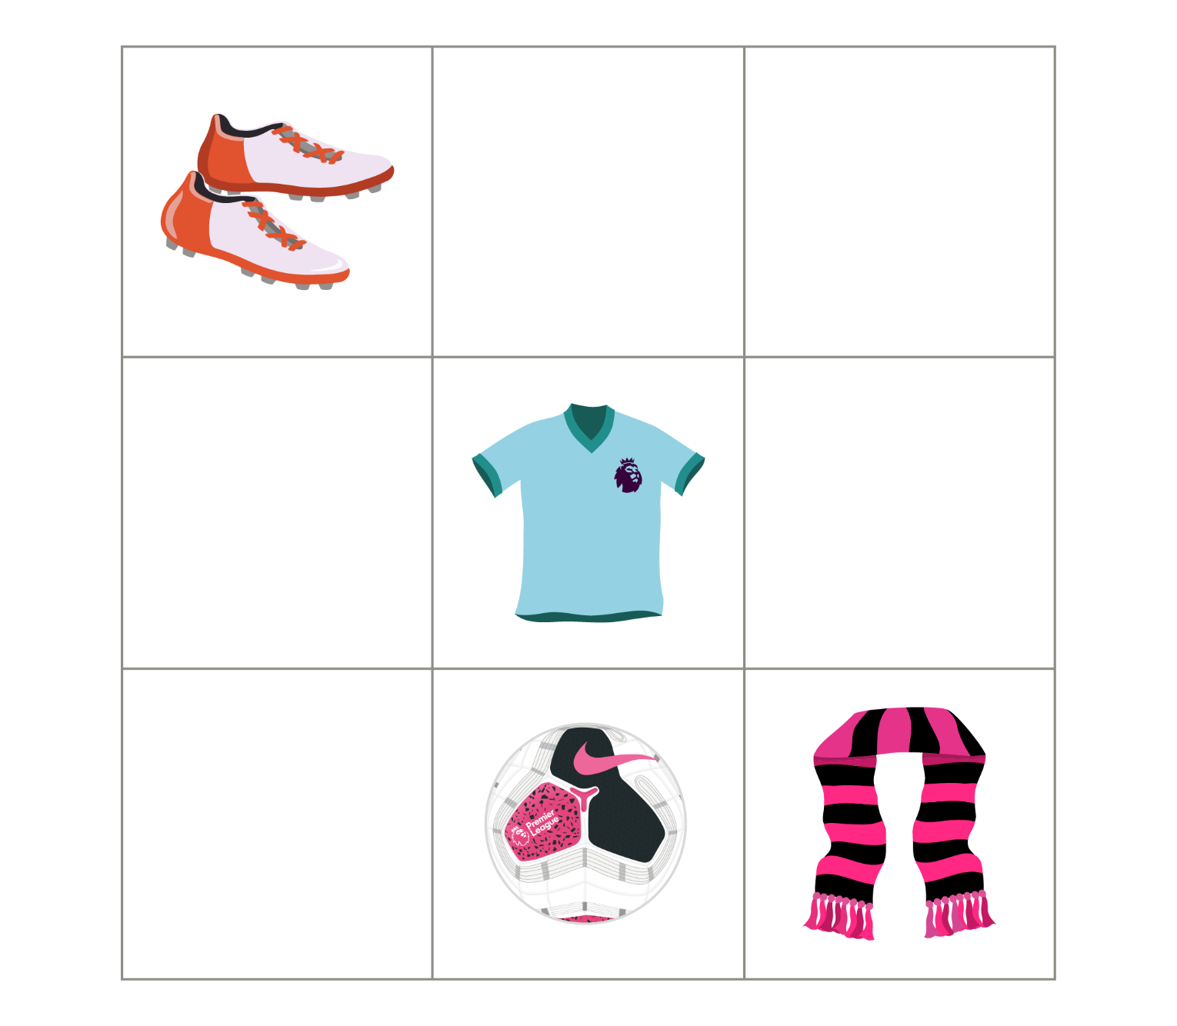

Q1.
What is above the ball?
The boots
The scarf
The shirt
Nothing

Slide 3
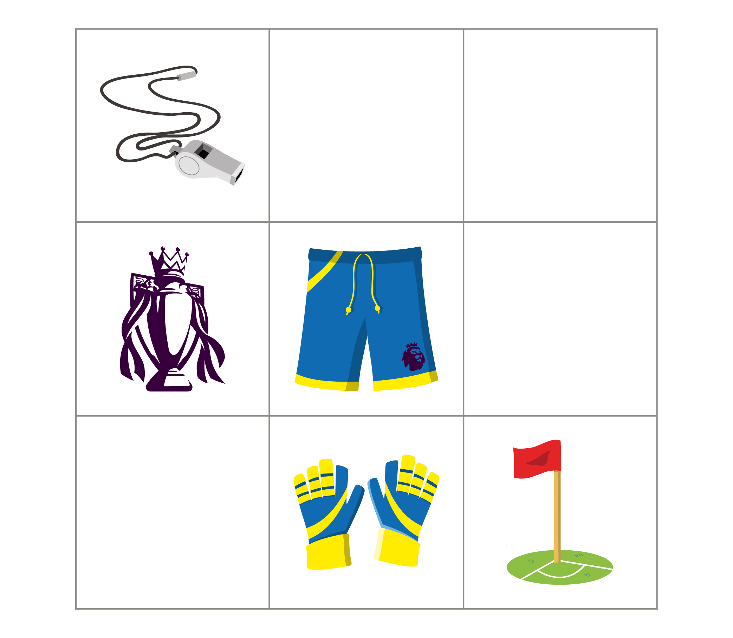
Q2.
What is below the shorts?
The gloves
The trophy
The flag
Nothing

Slide 4
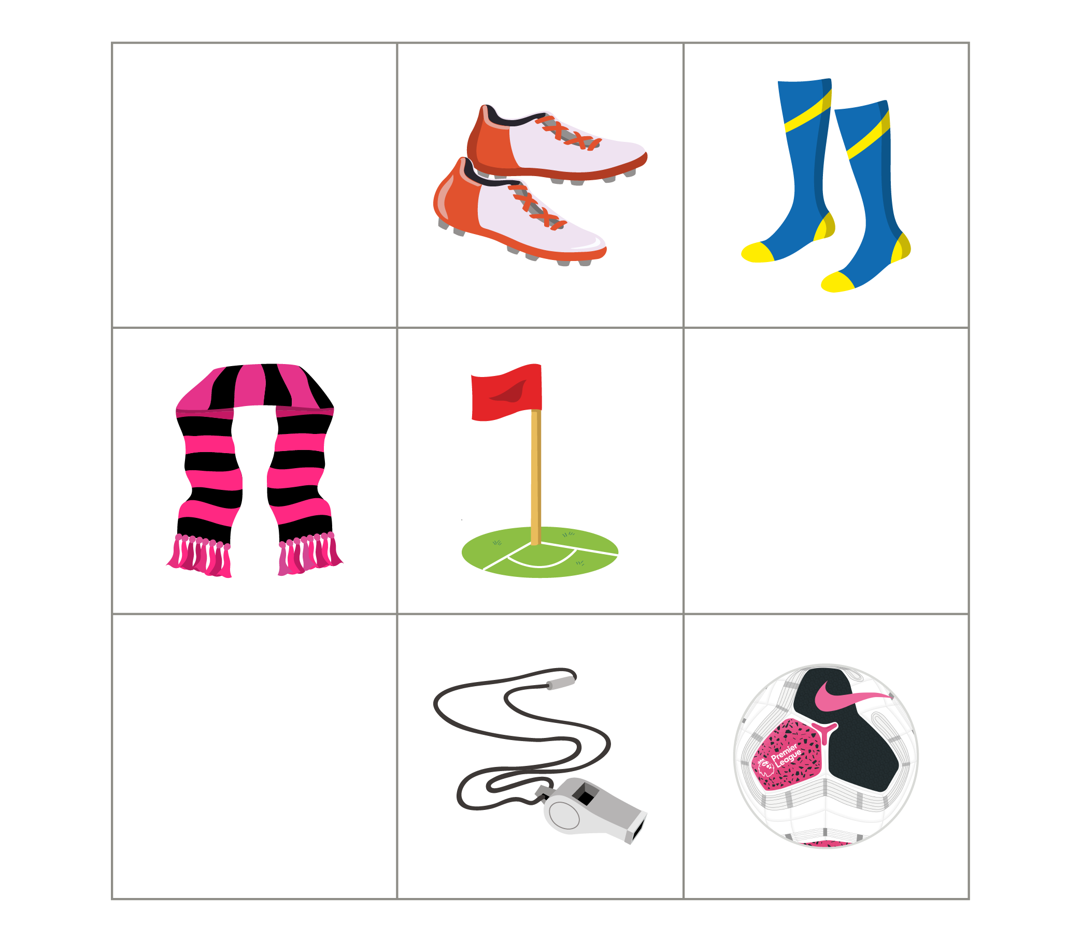
Q3.
What is to the right of the flag?
The scarf
The boots
The whistle
Nothing

Slide 5
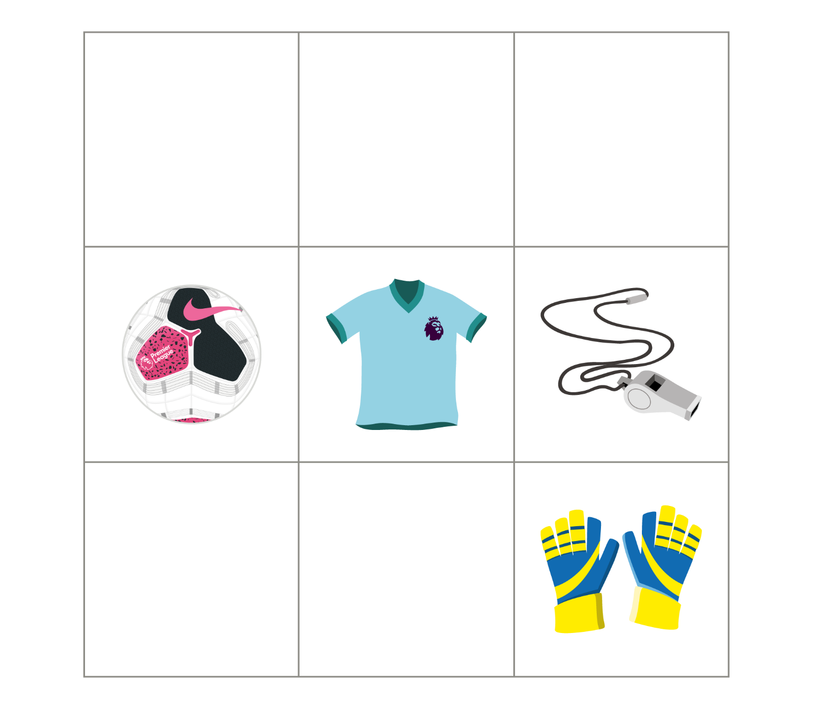
Q4.
Which object is in the middle?
The ball
The gloves
The shirt
The whistle

Slide 6
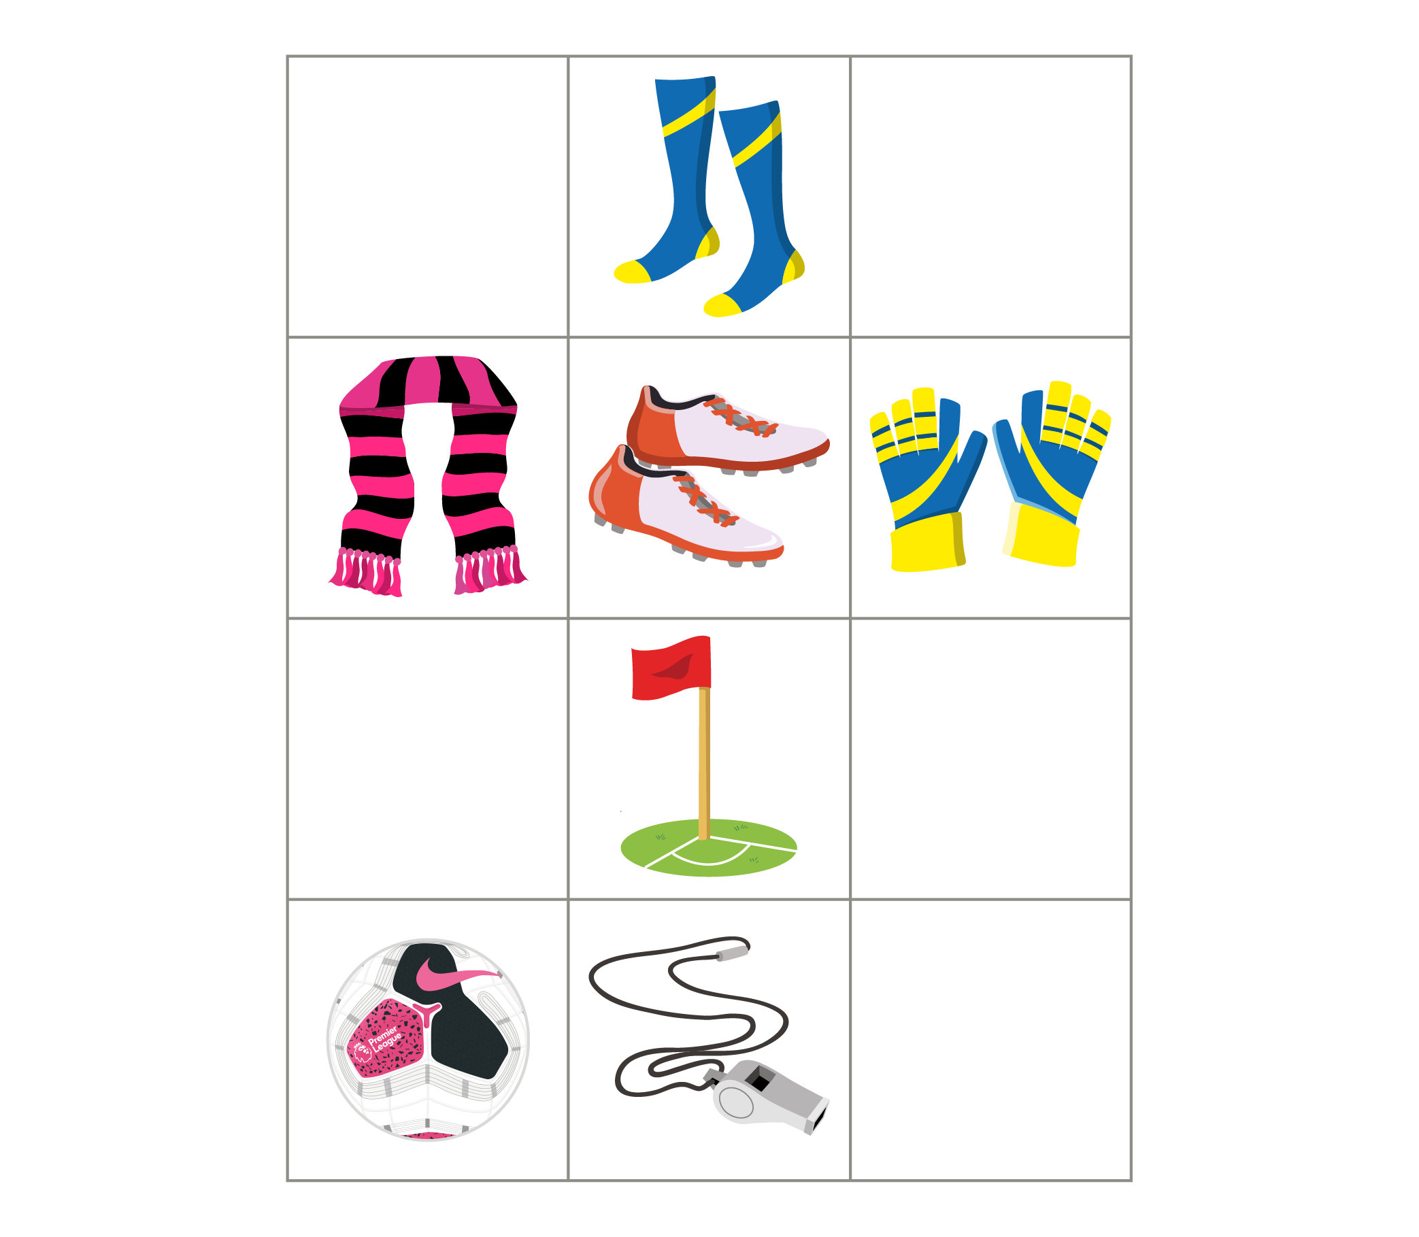
Q5.
What is between the whistle
and the boots?
The flag
The socks
The ball
Nothing

Slide 7
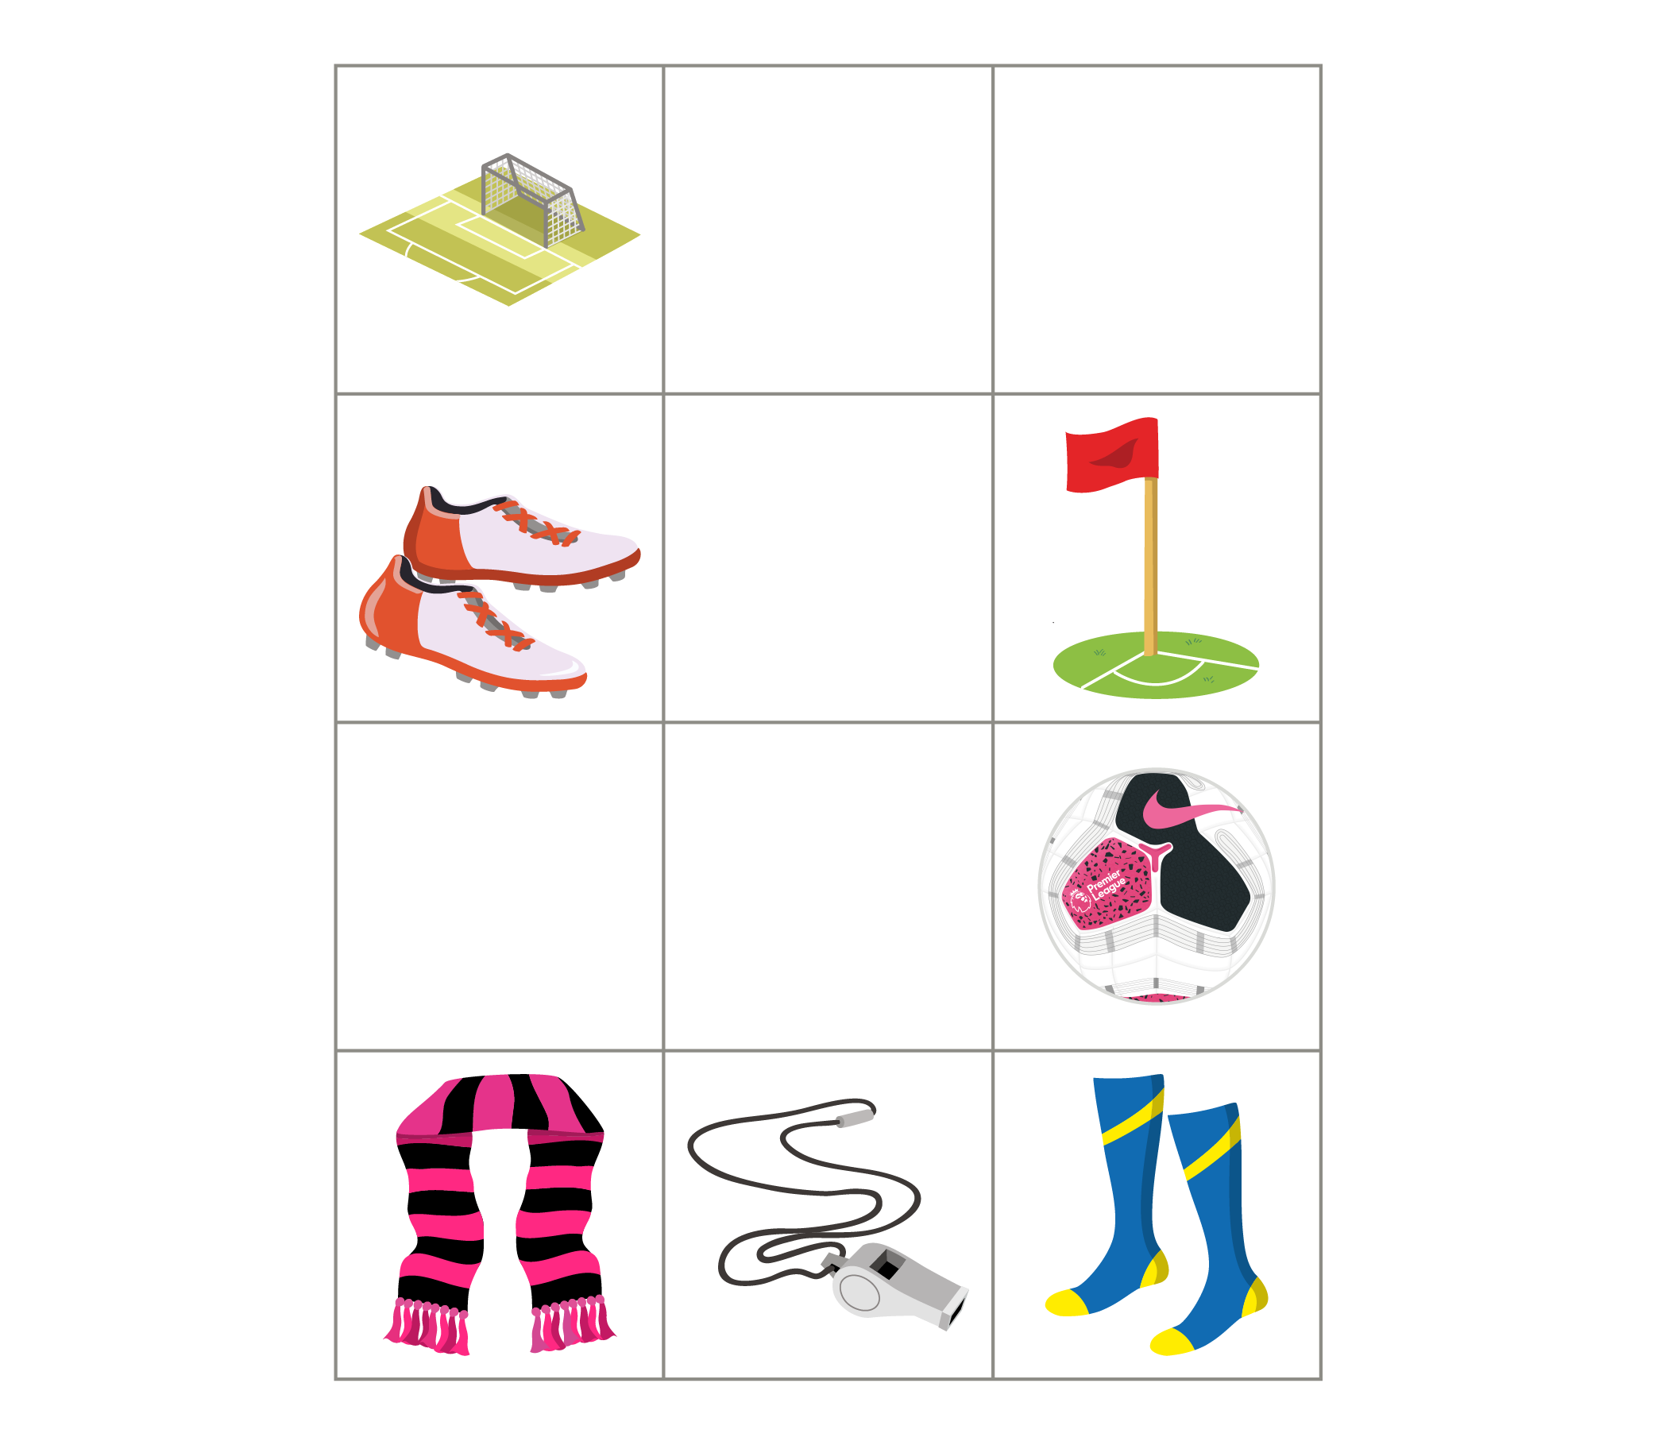
Q6.
The ________ are near the goal.
ball
boots
socks
scarf

Slide 8
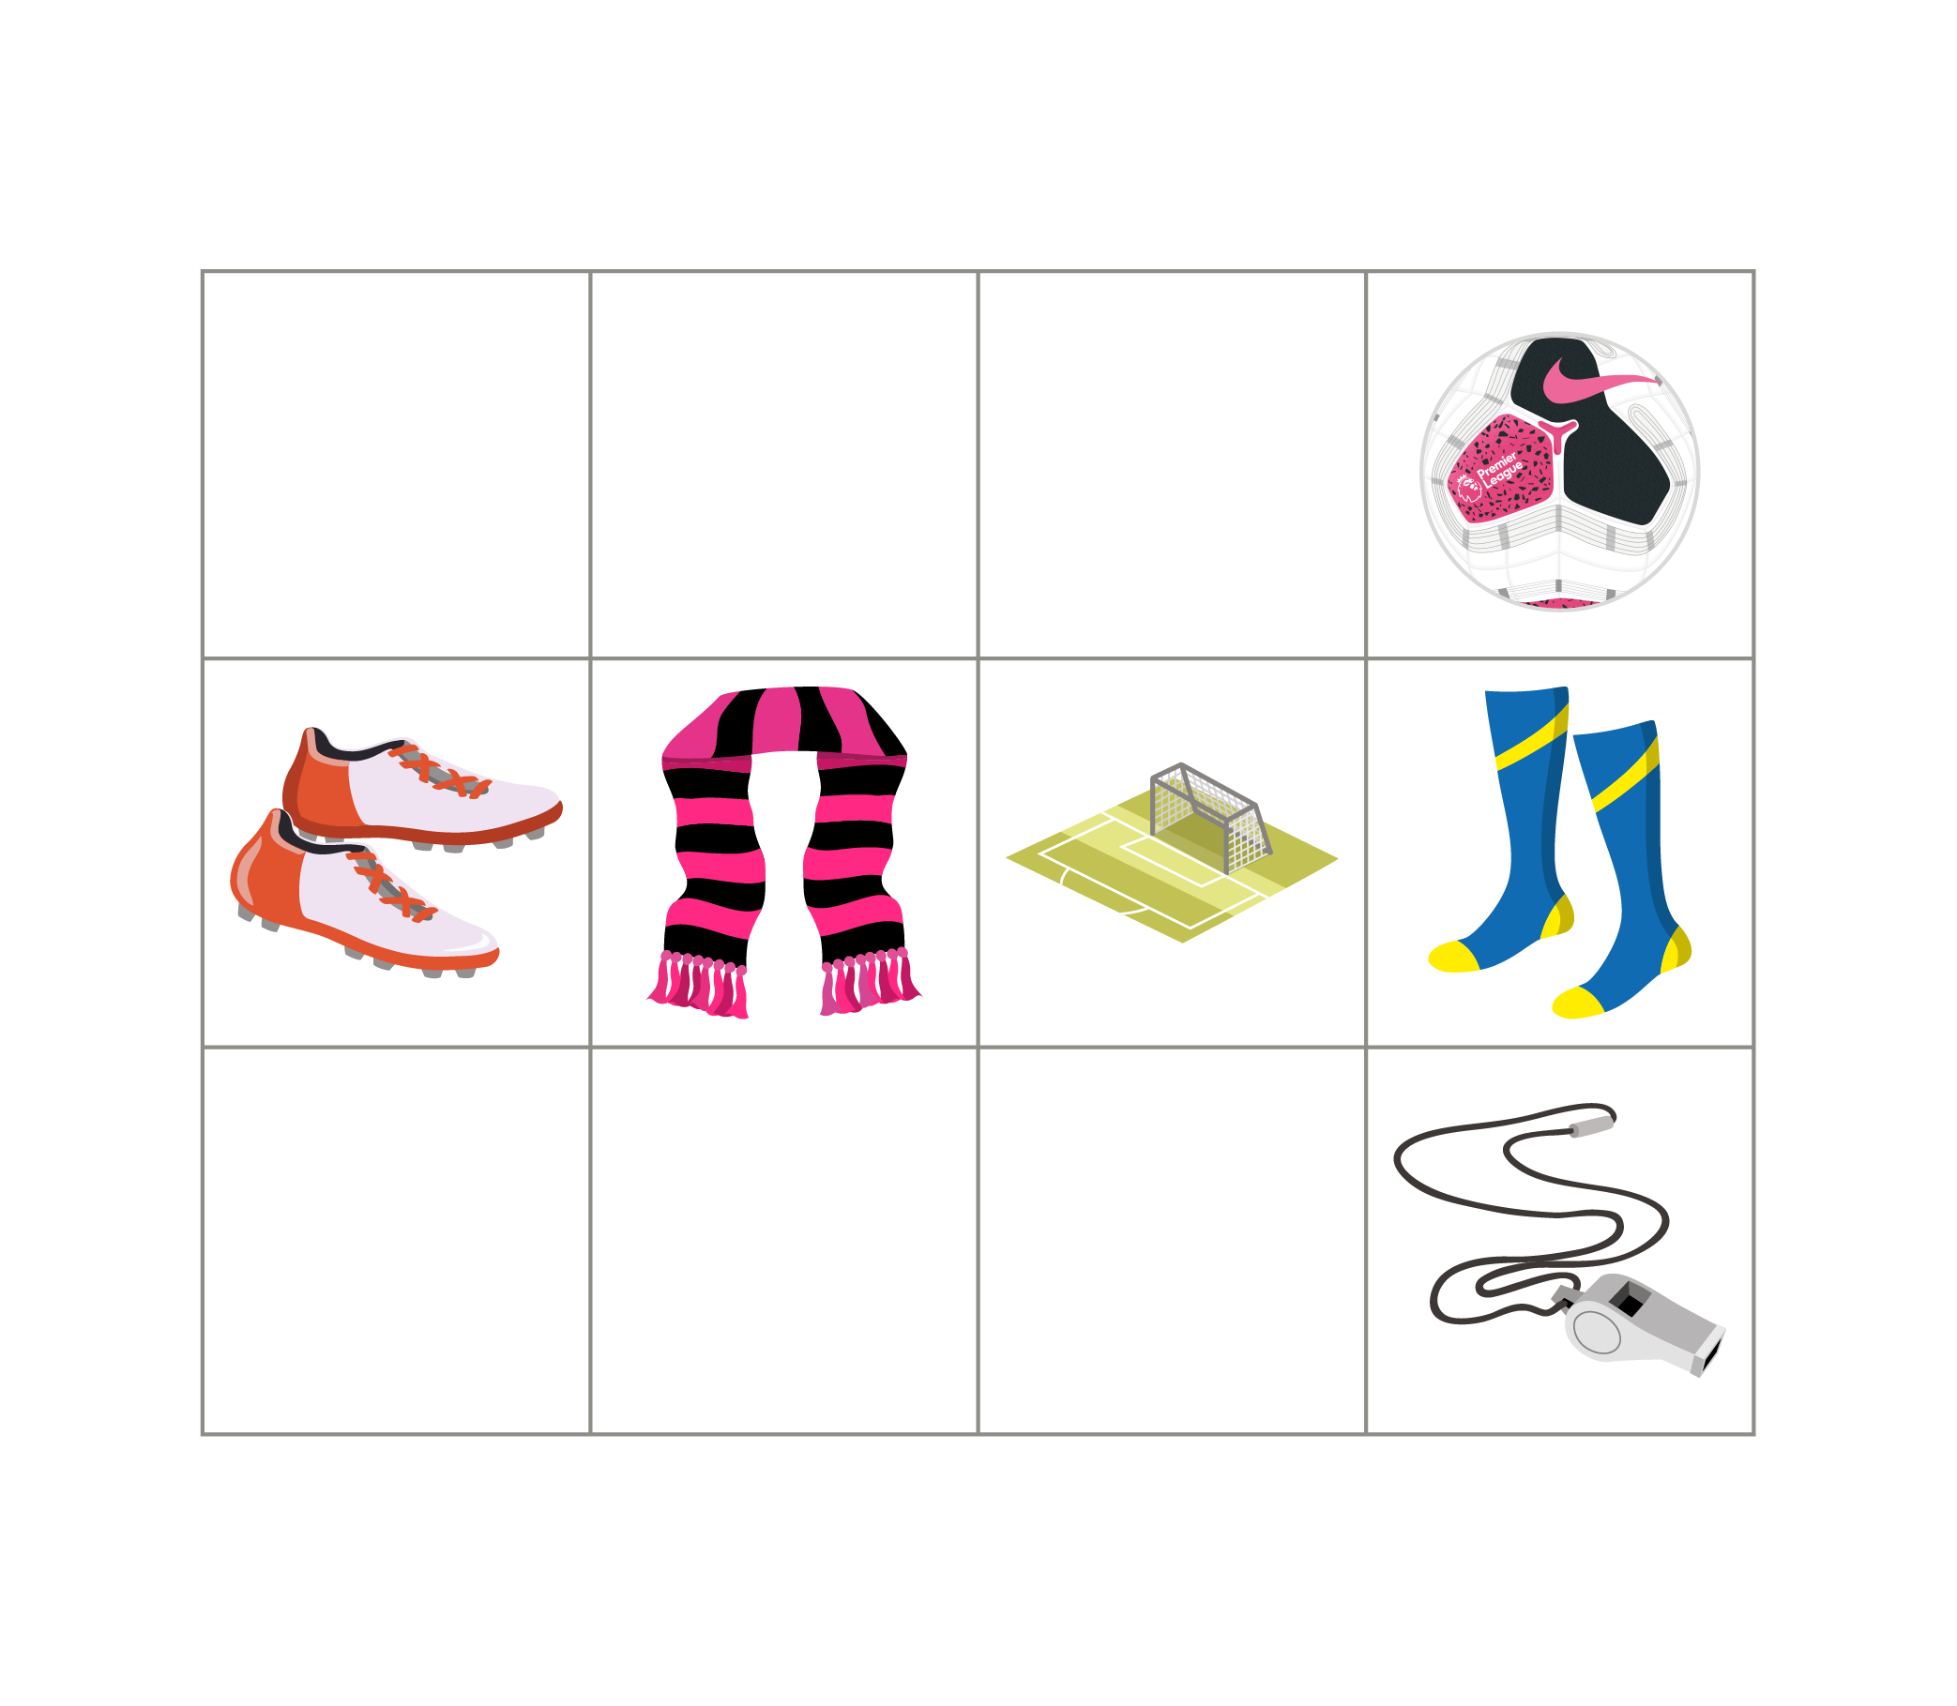
Q7.
Which of these is true?
The ball is at the top
The boots are at the bottom
The whistle is at the top
The socks are at the bottom

Slide 9
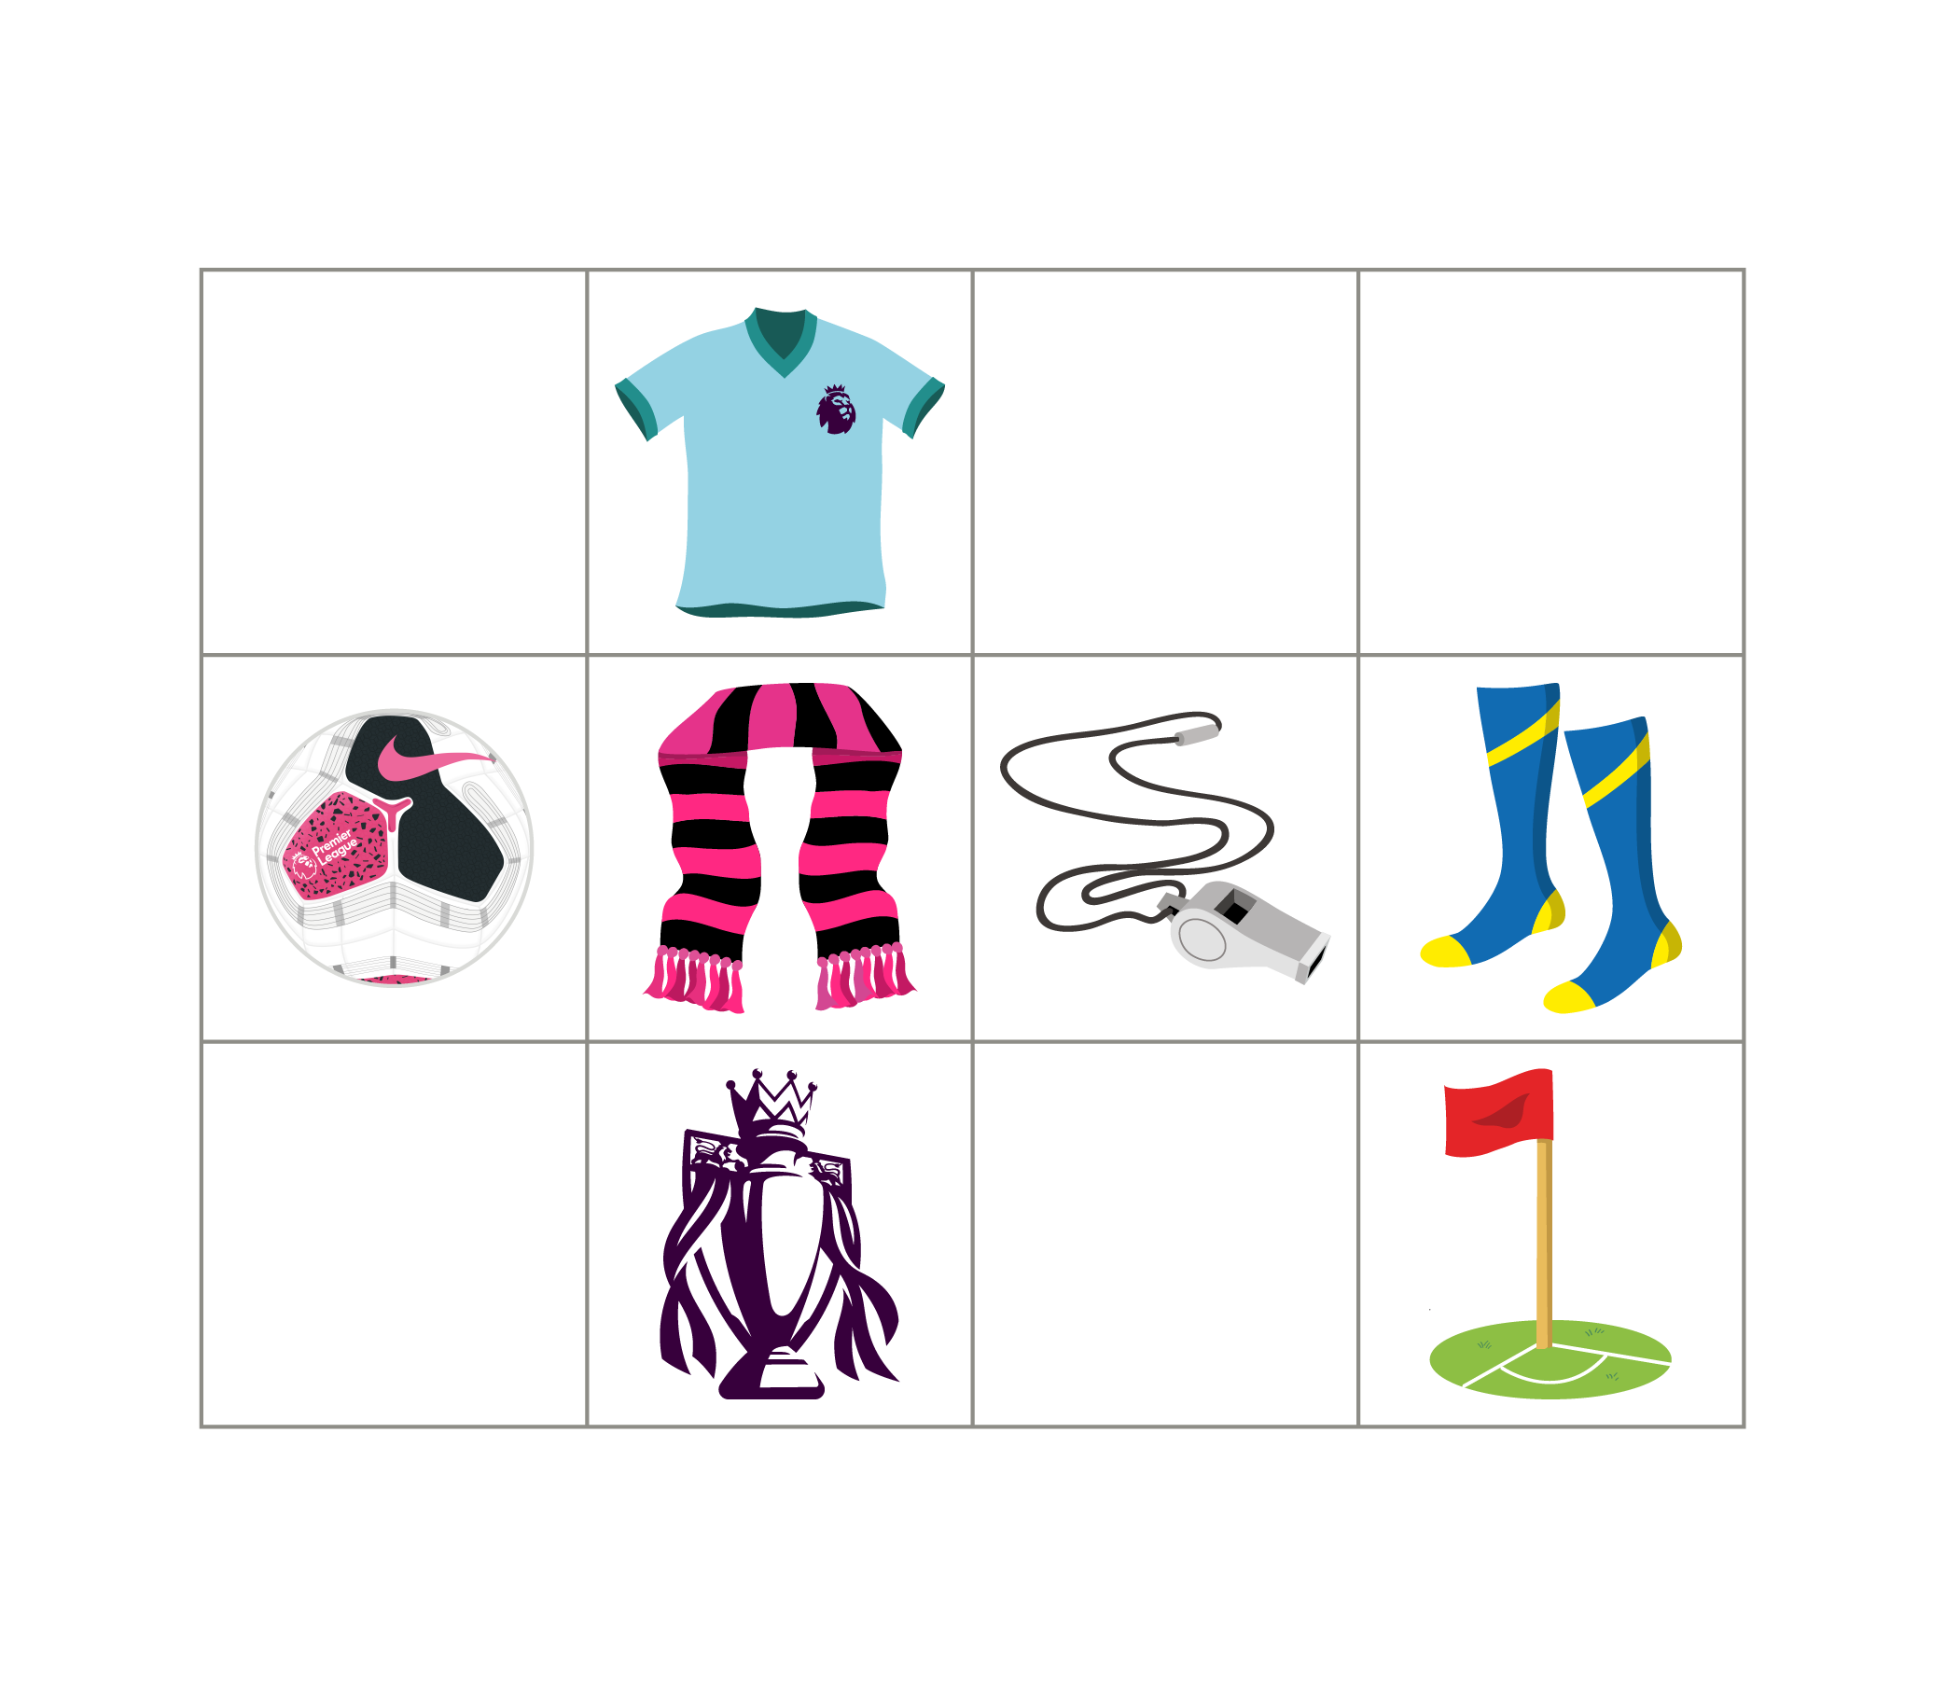
Q8.
What is two spaces above the trophy?
The flag
The scarf
The ball
The shirt

Slide 10
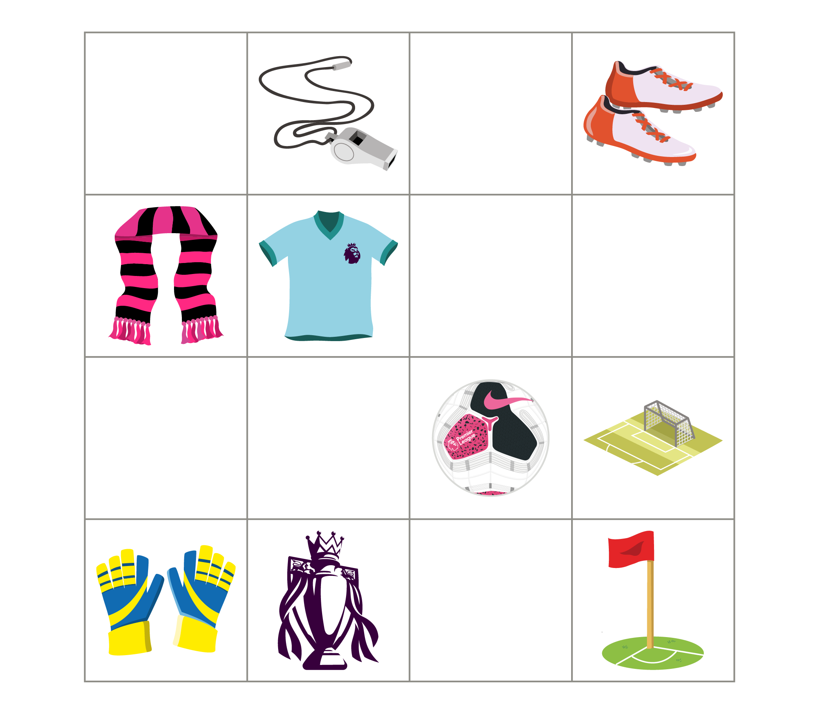
Q9.
What is three spaces to the left of the goal and one space up?
The gloves
The scarf
The boots
The shirt

Slide 11
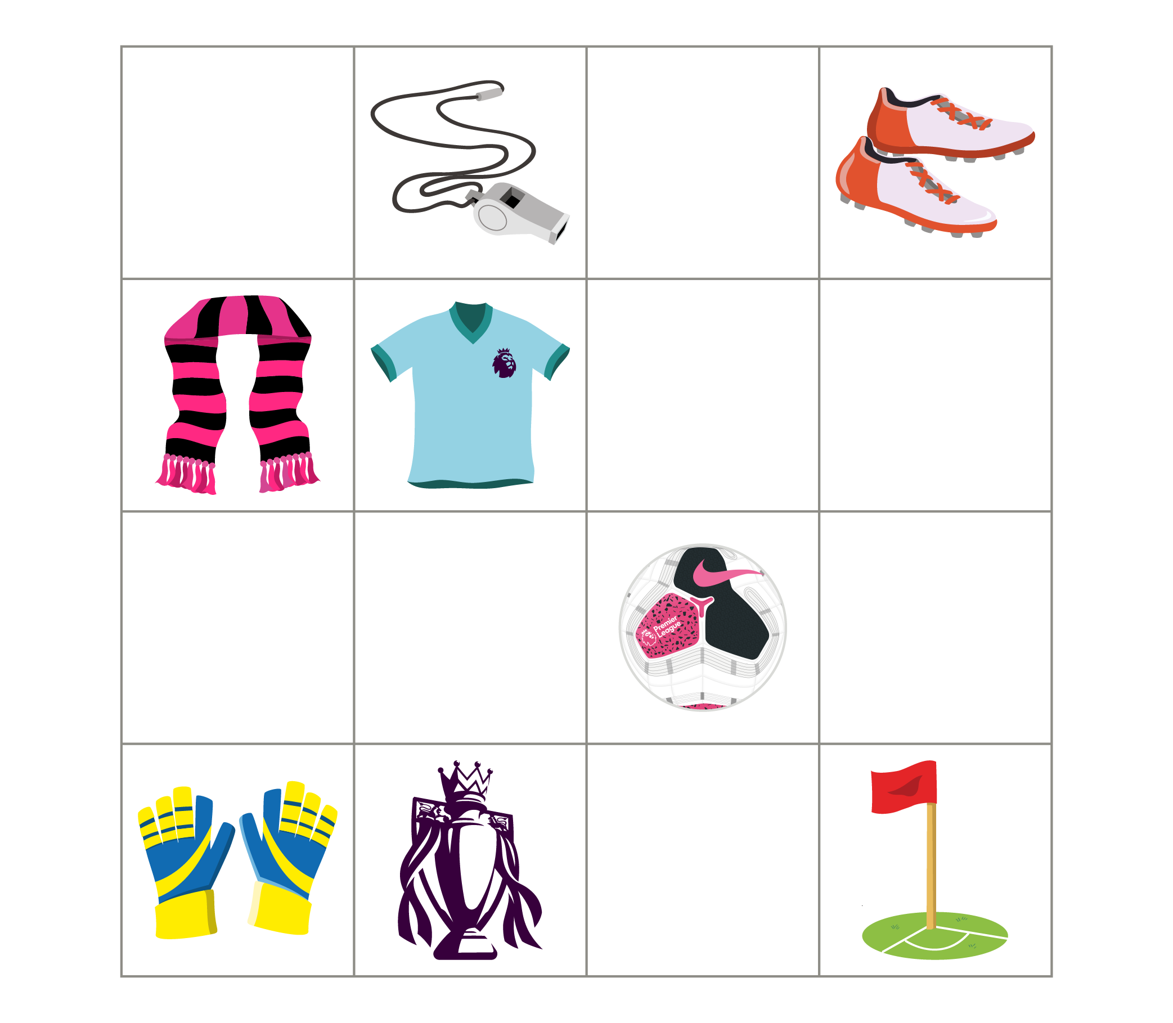
Q10.
What is two spaces down from the whistle and two to the right?
The ball
The boots
The flag
Nothing

Slide 12
Answers
Q1. The shirt
Q2. The gloves
Q3. Nothing
Q4. The shirt
Q5. The flag
Q6. boots
Q7. The ball is at the top
Q8. The shirt
Q9. The scarf
Q10. Nothing

