Slide 1
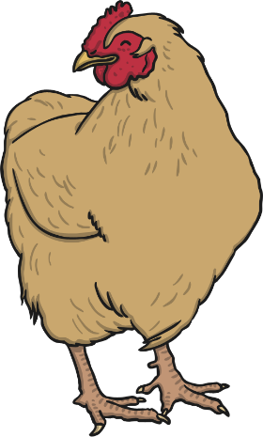



Living, No Longer Living and Never Lived

Slide 2
Aim
To sort and classify objects into categories.
Success Criteria
We are successful when we can:
Describe and discuss the categories.
Sort given objects into categories and give reasons for our choice.
Come up with our own examples to add to the categories.

Slide 3




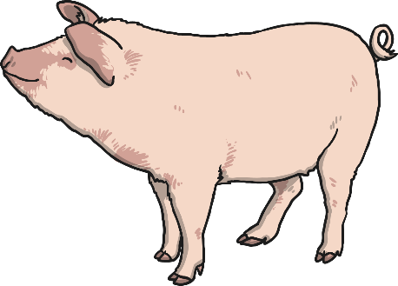

Living Things
What do all these things need to stay alive?

Slide 4






Never Lived
What do all these things have in common?

Slide 5





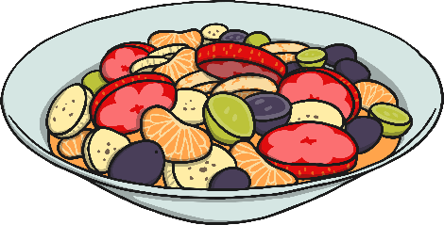
No Longer Living
What do these things have in common? Why are they no longer alive?

Slide 6
Plenary
Living, no longer living or never lived?
no longer living
living
never lived
Can you name another object for each category and discuss why it fits into the category you have chosen?

Slide 7


















Which are living, which are no longer living
and which never lived?
living
no longer living
never lived

