Slide 2



Performing a Poem Challenge
What do you think makes a great poetry performance?
Think about…
your
voice
your
pace
any extra actions or sounds
your body
language

Slide 3

As You Begin
Remember to face your body towards the audience.
Remember to face your body towards the audience.
Look at the audience when you are performing.
Read the title first.
Look at the audience when you are performing.
Read the title first.
twinkl.co.uk

Slide 4
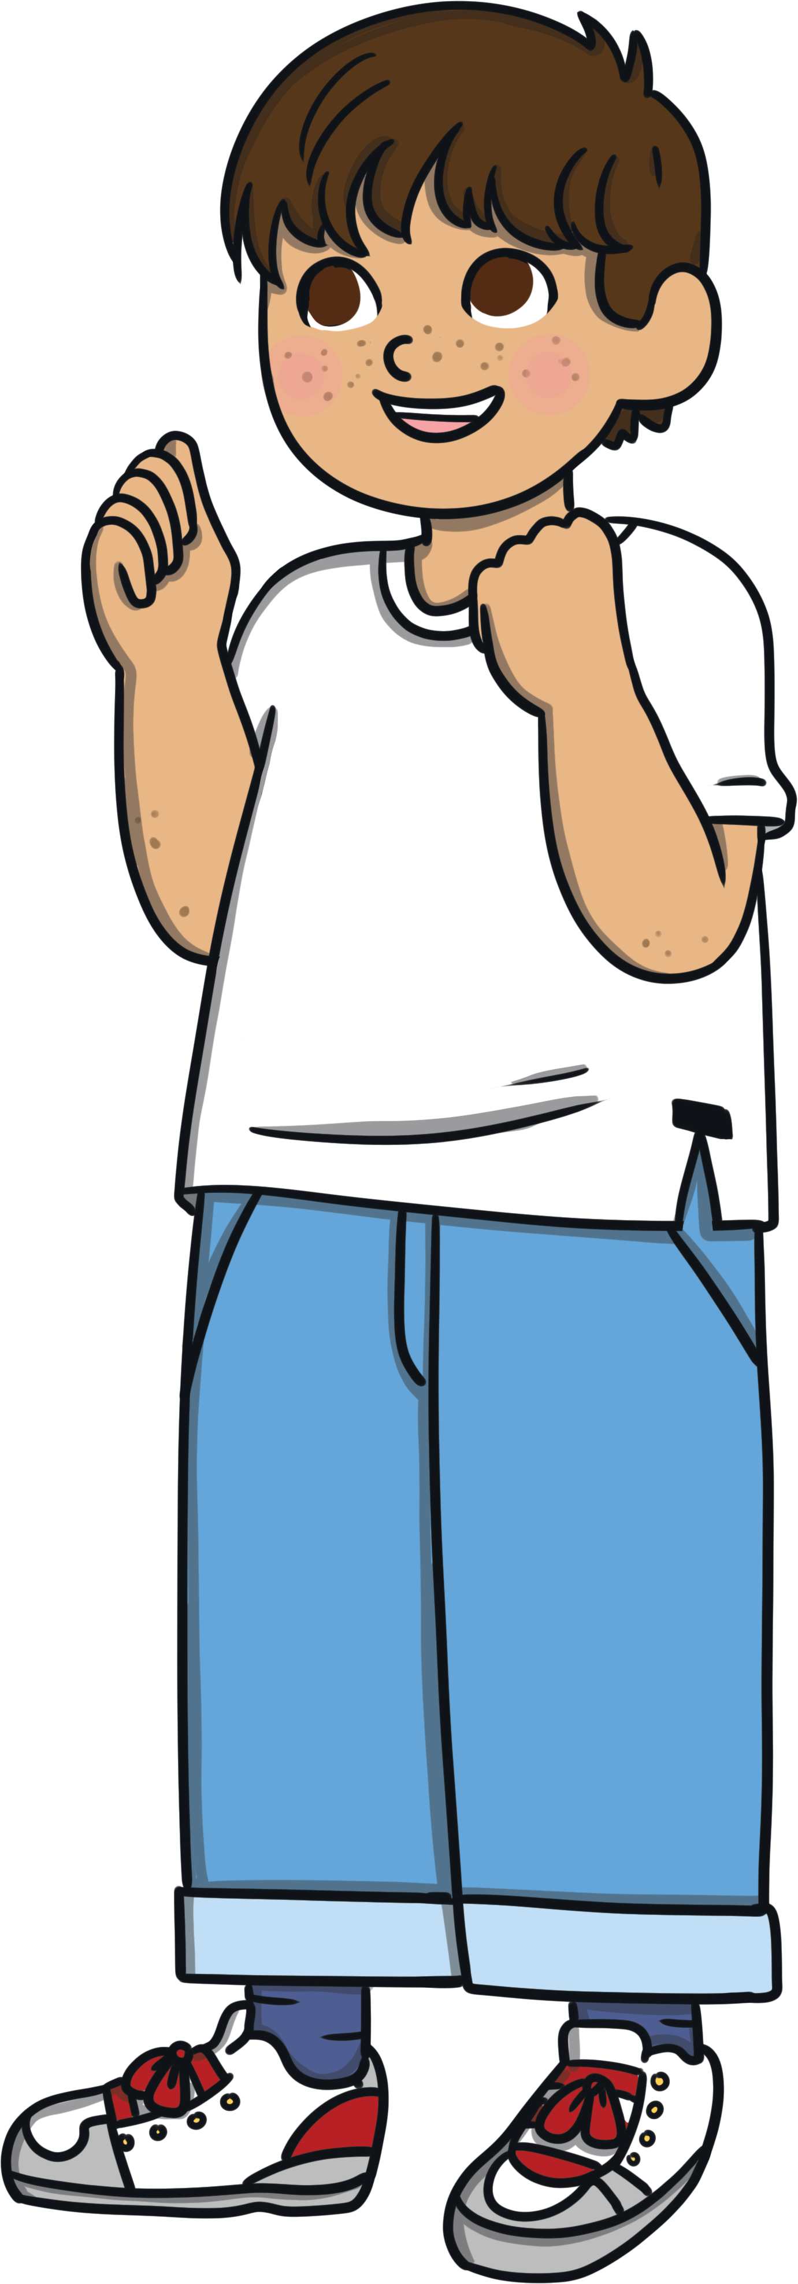

Think about Your Voice
Use a clear voice as
you perform.
Remember to speak
so your friends can
hear you.
Read the poem at a steady pace.
Could you add expression to your voice?

Slide 5
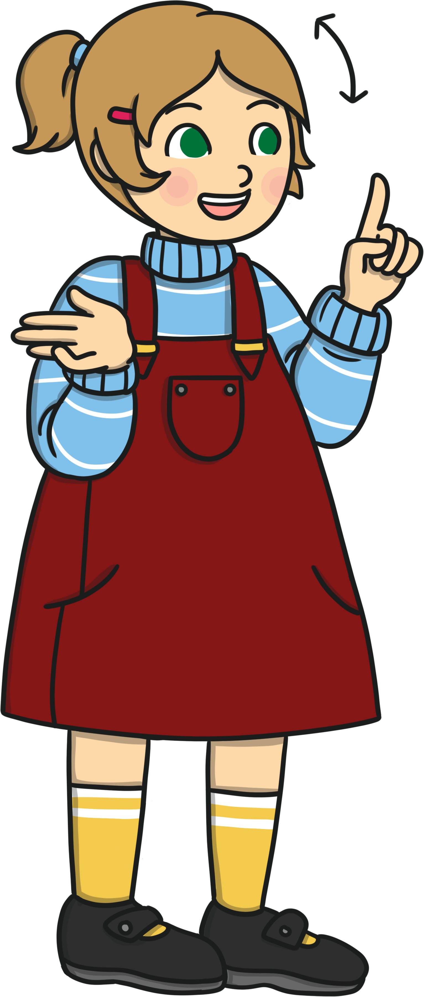

Adding Some More Interest
Could you add some actions to your poem?
Could you add use some sounds using musical instruments?

Slide 6

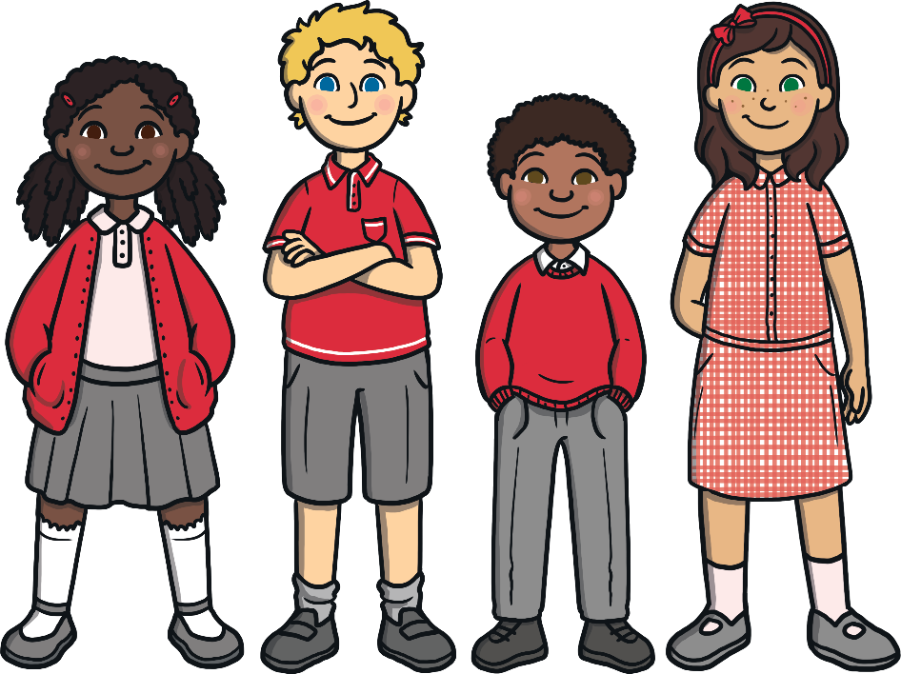

Challenge
Take some time to practise your performance skills with your friends.

Slide 7








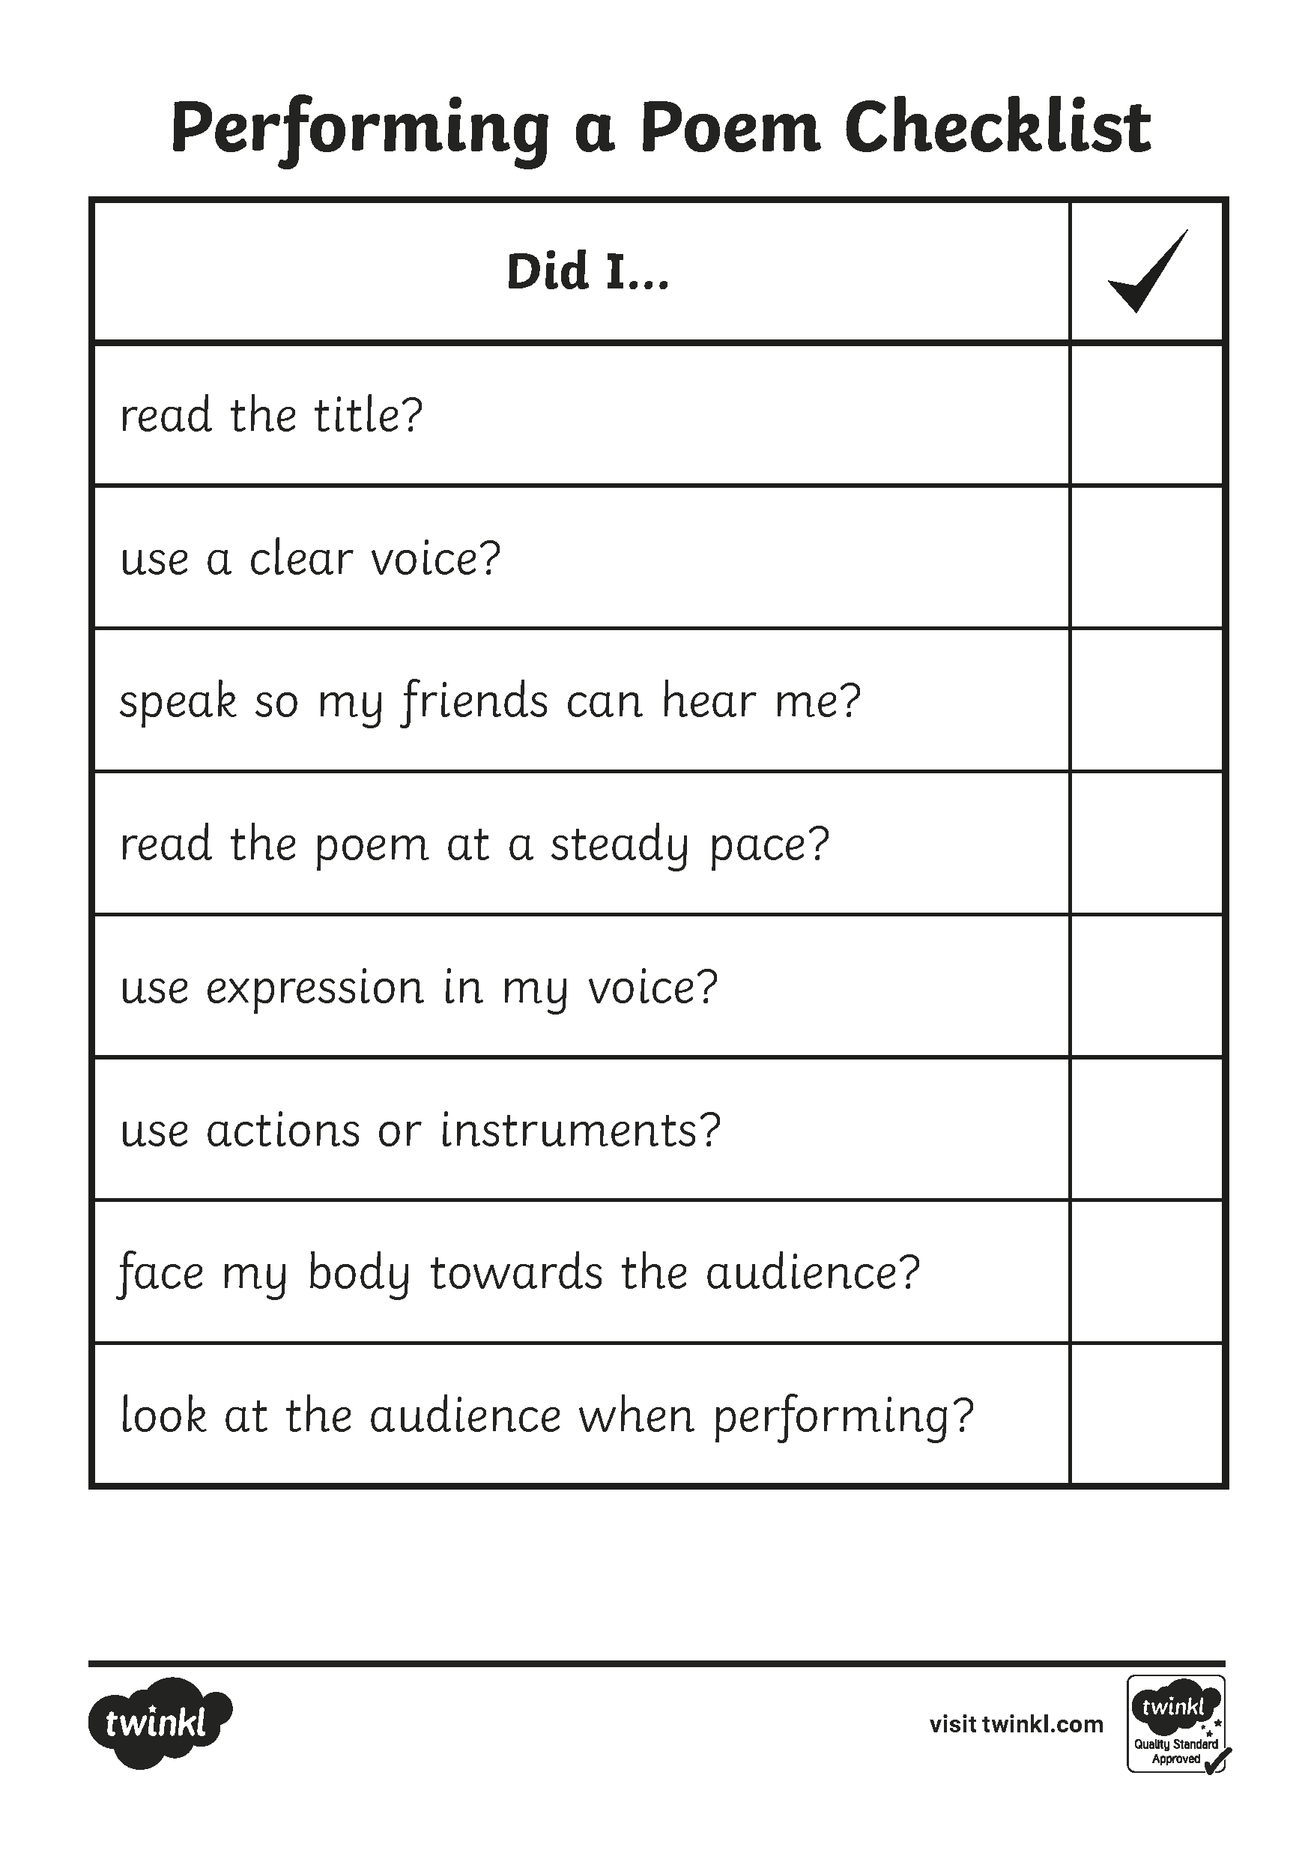
How Well Did Your Poetry Performance Go?

