Slide 2
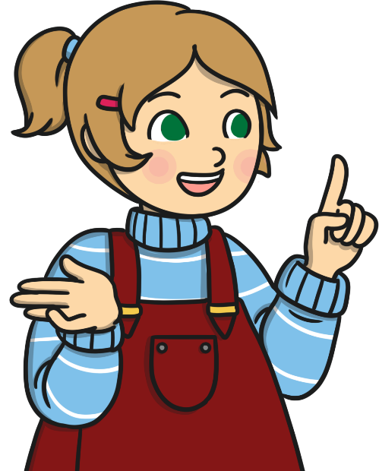
What Is Poetry?
Poetry is written by a poet.
When a poet writes a poem, they try to get you to use your imagination or feelings when you are reading it. They do this by thinking about what words mean and how they sound. The poet might change the order of words to make them sound a certain way.
Sometimes, poems have rhyming words in them.
Poetry is meant
to be read aloud.
poet – Someone who writes poetry.

Slide 3
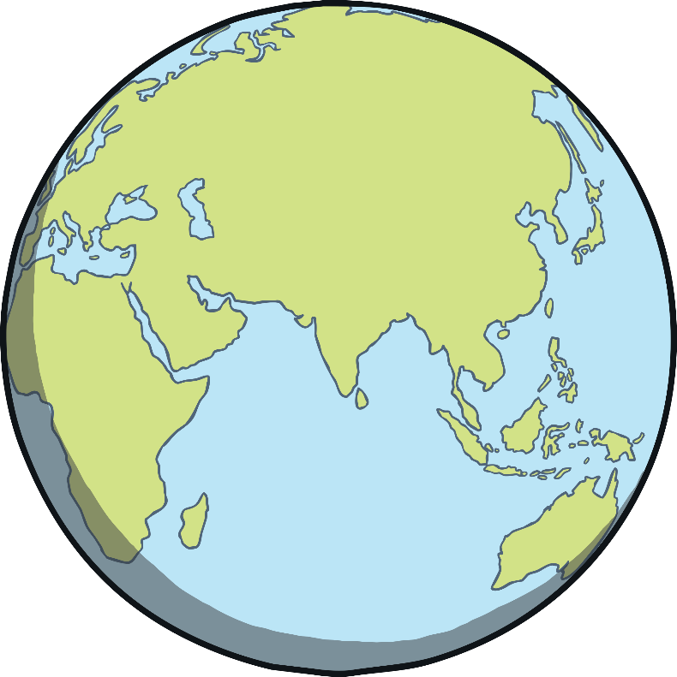
What Is World Poetry Day?
World Poetry Day is on the 21st March.
It was started by a group called UNESCO. This group celebrates the things that make countries all around the world special.
World Poetry Day celebrates poems in lots of different languages and from lots of different countries.
It encourages people to write poetry and recite poetry.
recite – Say out loud.

Slide 4


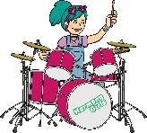
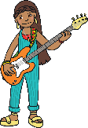






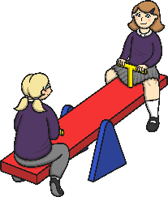
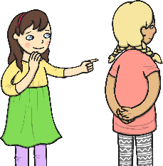
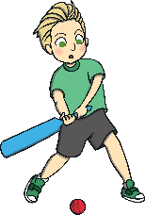
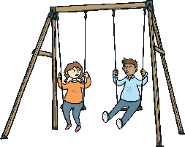

Rhyming Words
Some poetry has rhyming words at the end of lines. When words rhyme, they start with different sounds, but sound the same at the end of the words. So ‘cat’ rhymes with ‘bat’ and ‘hot’ rhymes with ‘lot’.
Can you match up these rhyming words?
sun
band
joke
bit
ring
fun
poke
hit
swing
land

Slide 5
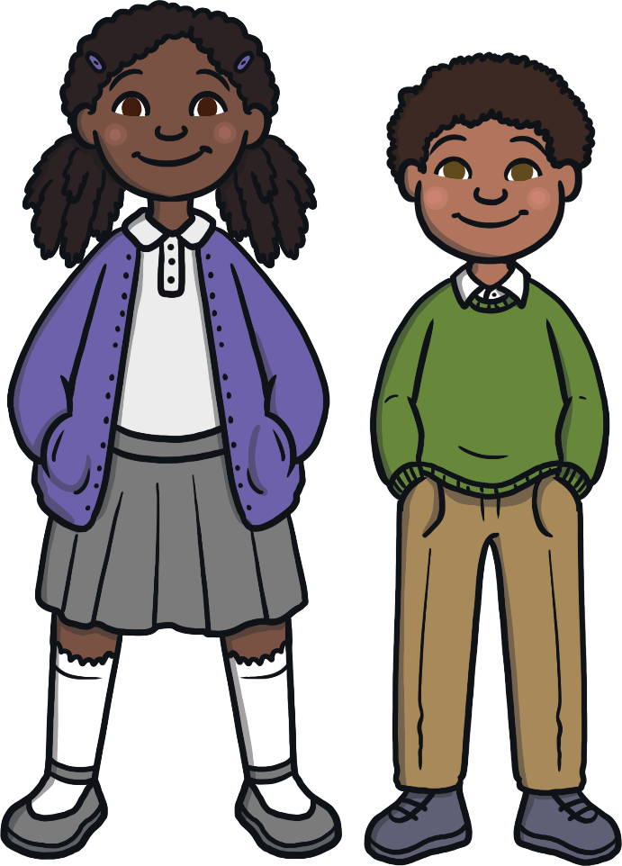
Rhythm
In poetry, rhythm is the pattern that the words make and how they sound when put together. It can make the poem sound fun to read and can make it easier for you to learn the poem off by heart.
Look at this sentence:
My brother has a jumper and my sister has a skirt.
Try reading the sentence out loud and listen to the pattern the words make.
This is rhythm.

Slide 6
Limericks
There are over 50 types of poem.
This one is a limerick.
Limericks are funny and have rhyming words.
There once was a girl from Bombay,
Who always had something to say.
Her tongue went too fast,
Her voice didn’t last,
And was quiet the rest of the day.
?
Can you spot the rhyming words at the end of some lines?
?
How does the rhythm of the poem sound?

Slide 7
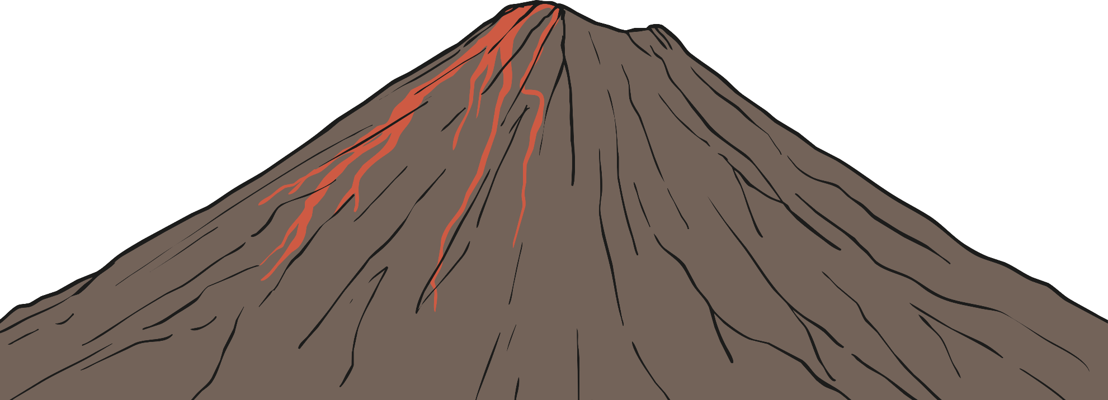
Shape Poetry
Shape poems are written in the shape of the thing the poem is about. Look at this poem.
?
What is the shape of the poem?
?
Does it have rhyming words at the end of lines?
A
huge rock
that rumbles
and roars, wrecking
the ground all around it.
It shoots; sizzling, steaming, scorching lava
like a monster spitting out hot liquid into the air.
Like a smoking dragon, it finally starts to calm down.
The chaos stops and it goes back to being a deadly and dangerous rock.

Slide 8
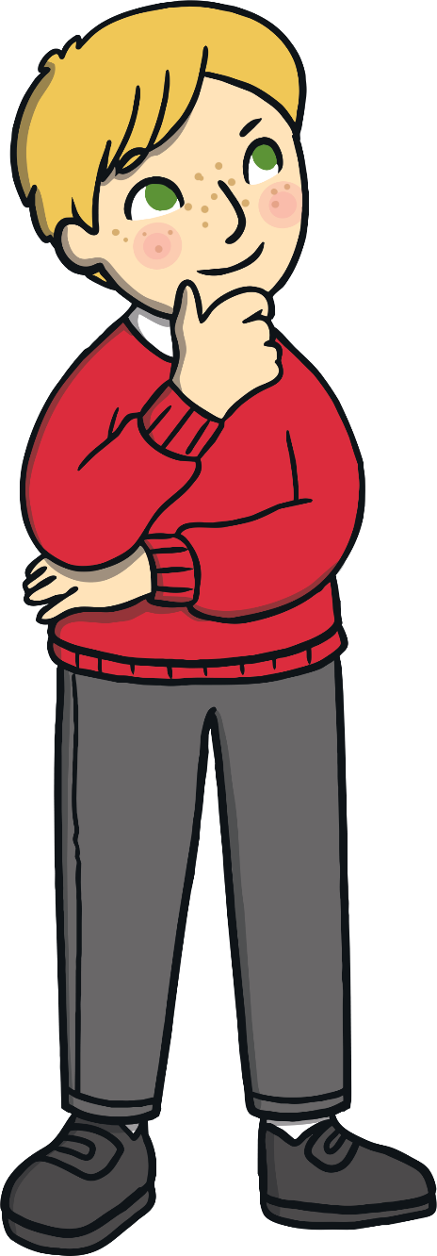
Acrostic Poetry
The first letter of each line spells out what the poem is about.
An acrostic poem
Could be about anything you want
Really.
Of course, you can
Say what you like.
That’s what’s so easy:
I might write one right now.
Can you guess what it’ll be about?
?
What do the letters in orange spell?

Slide 9
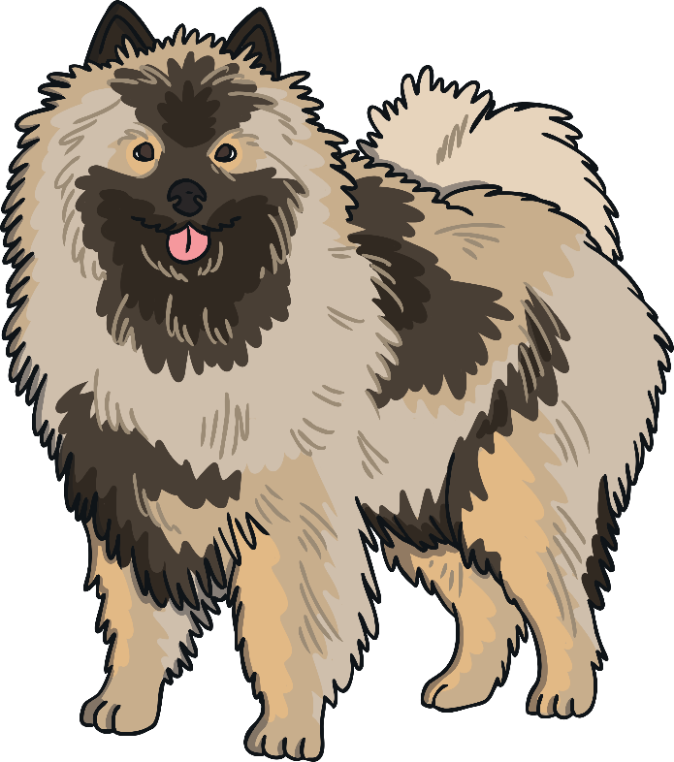
Free Verse
Free verse has no rhyming words. Lines can be full sentences or even just one word.
There’s nothing like a dog
For cheering you up when you’re blue
By licking your face, or
Falling at your feet.
There’s nothing like a dog
For chewing your new shoes
Or running off with your book
Woofing like mad!
There’s nothing like a dog
For always wanting to be with you,
Following you everywhere,
Being your best friend forever.

Slide 10
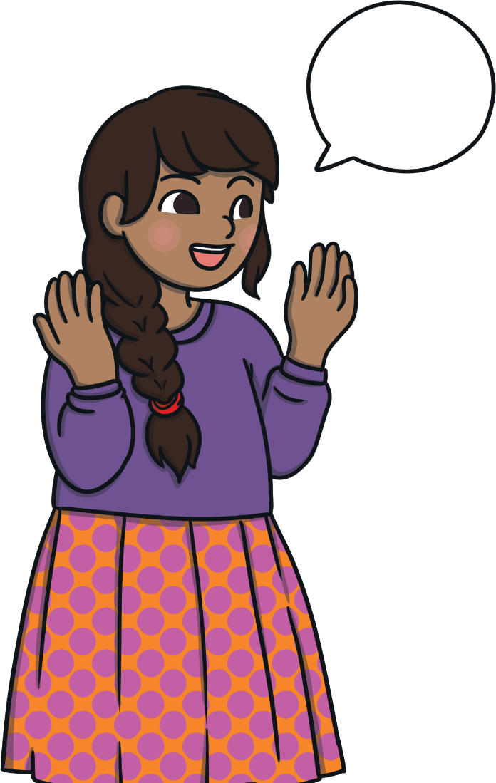
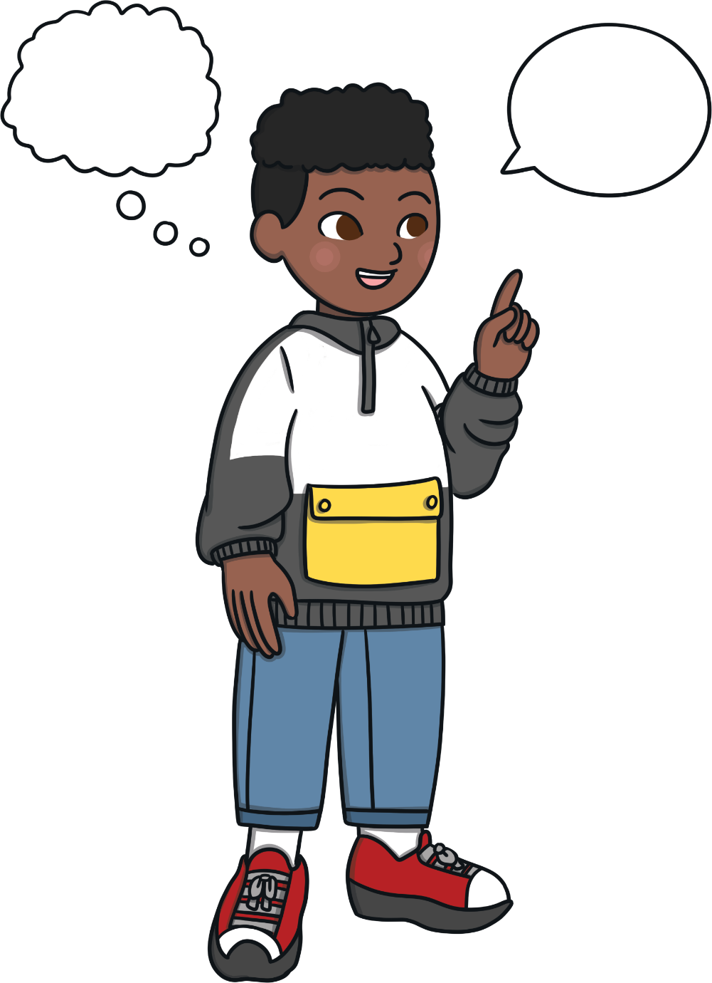

Can you explain the features of each type of poem?
shape
poetry
acrostic
poetry
free
verse
limerick

