Slide 1


Slide 2
Aim
To find out about Captain Scott’s journey to the Antarctic.
Success Criteria
To think of reasons for and against Scott going to the Antarctic.
To write a diary entry from the point of view of Captain Scott on the journey back from the South Pole.

Slide 3

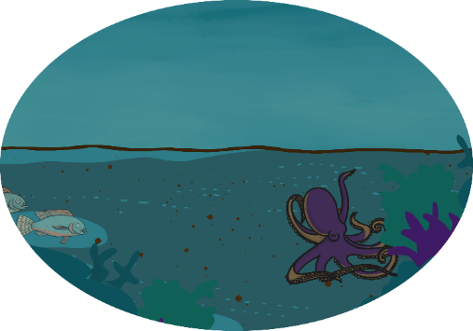

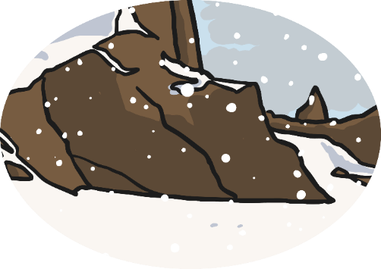

What parts of the world could be explored?
deep sea
deserts
polar
regions
jungles

Slide 4
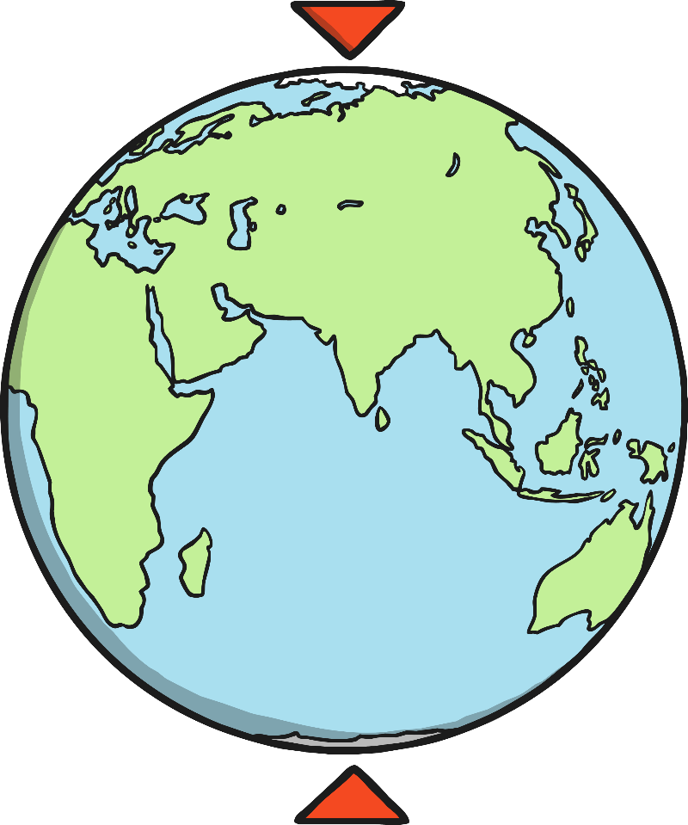
The Arctic and the Antarctic
The Arctic
The Arctic is the polar region at the northernmost part of the Earth. The North Pole is the point at the northernmost part of the Earth.
The Antarctic
The Antarctic is the polar region at the southernmost part of the Earth. The South Pole is the point at the southernmost part of the Earth.

Slide 5
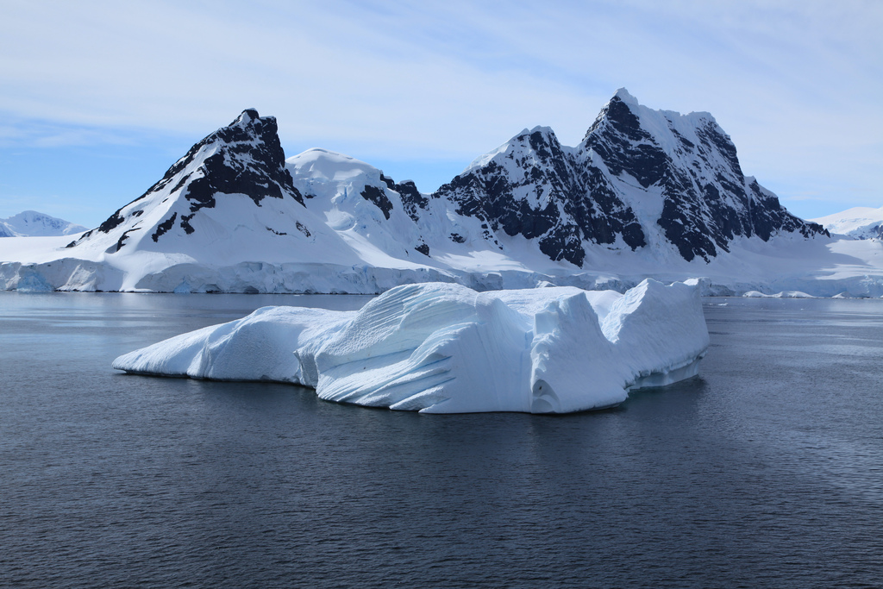
Antarctica
Antarctica is an enormous continent. Britain could fit into it more than 50 times! More than 99% of it is covered in ice. In places, this ice is more than three miles thick!
It is windy and extremely cold. No people live there permanently and there are no life forms at all except from around the coast.
Photo courtesy Liam Quinn(@flickr.com) - - granted under creative commons licence – attribution

Slide 6
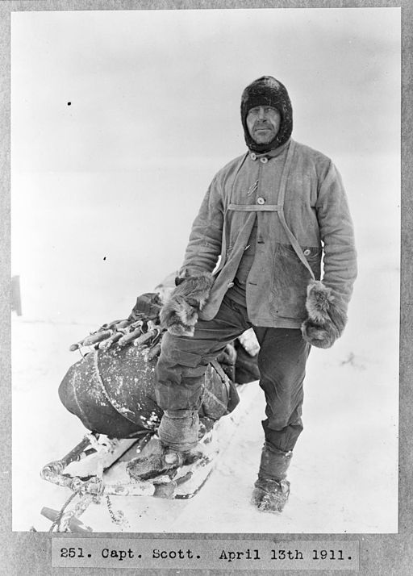
Who has explored the Antarctic?
Captain Robert Falcon Scott was born in Devon in 1868 and became an officer in the Royal Navy.
He led two expeditions to Antarctica. The first took place between 1901 – 1904. in 1910, he sailed out for his second voyage there.
The purpose of the expeditions was to find out more about the animals, the weather and the land of Antarctica.
Scott and his fellow explorers also wanted to be the first to reach the South Pole.
Can you think of reasons why the Antarctic would be a difficult place to cross?

Slide 7

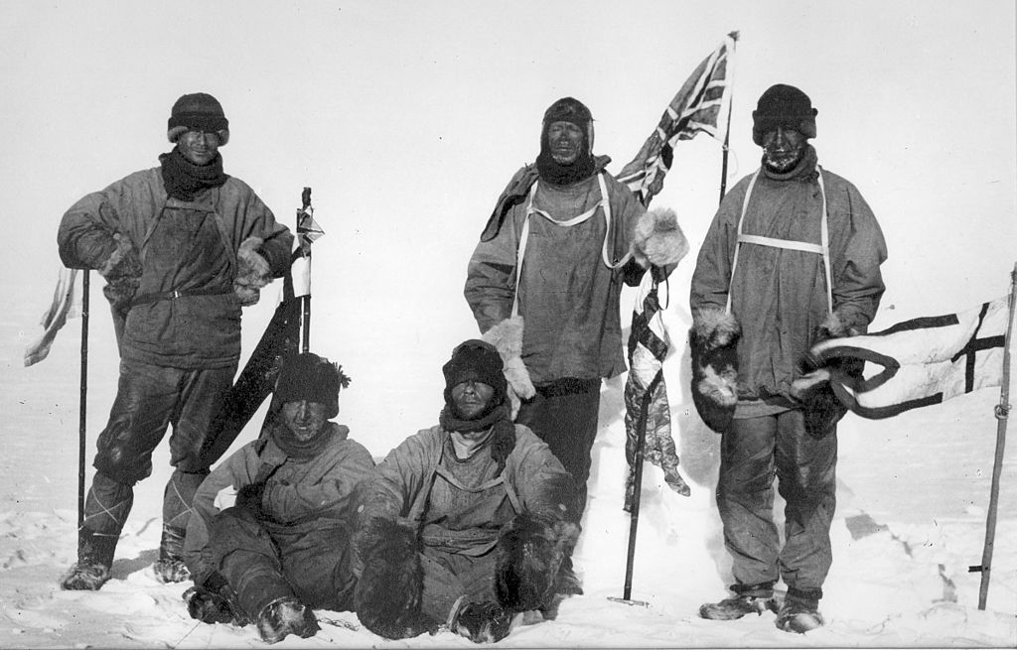
Robert Falcon Scott
Should Scott and his companions have gone to the Antarctic?
Was it a good idea to go there?
Can you think of reasons for and against Scott going to the Antarctic?
Photo courtesy of Henry Bowers (1883–1912) [Public domain], via Wikimedia Commons

Slide 8
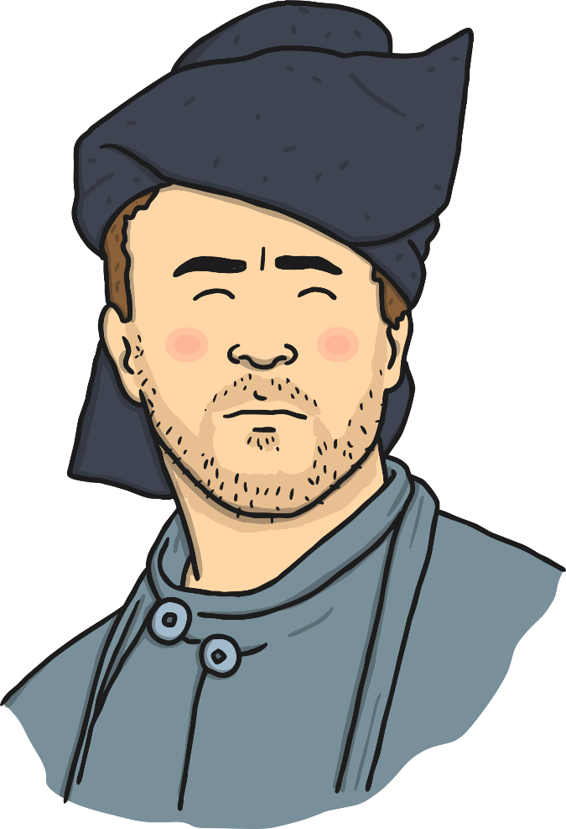
Conscience Alley
For
Against

Slide 9
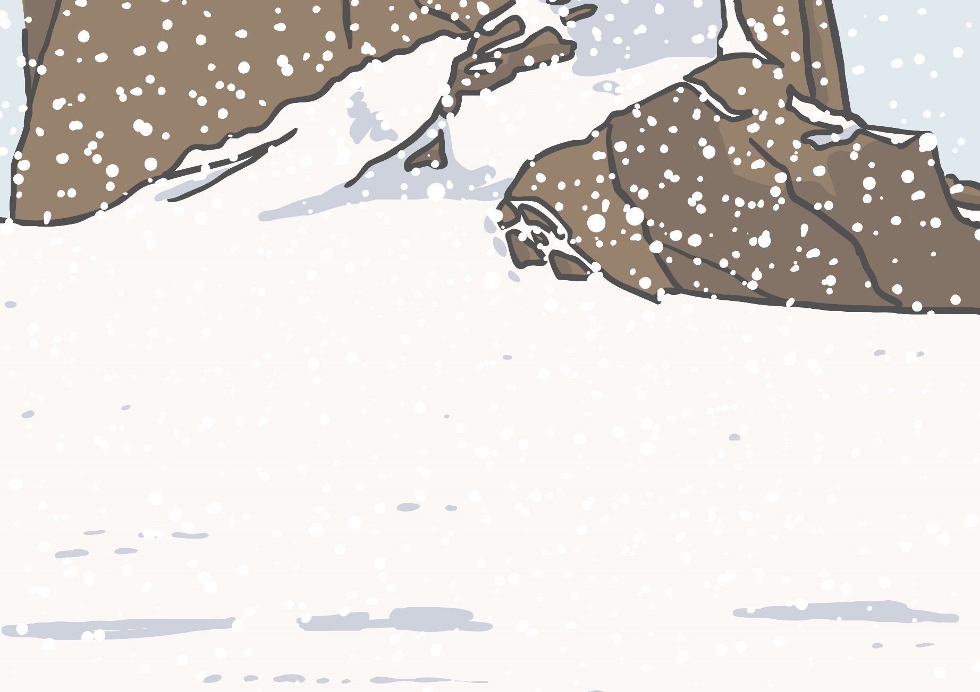
What happened to
Captain Scott?

Slide 10
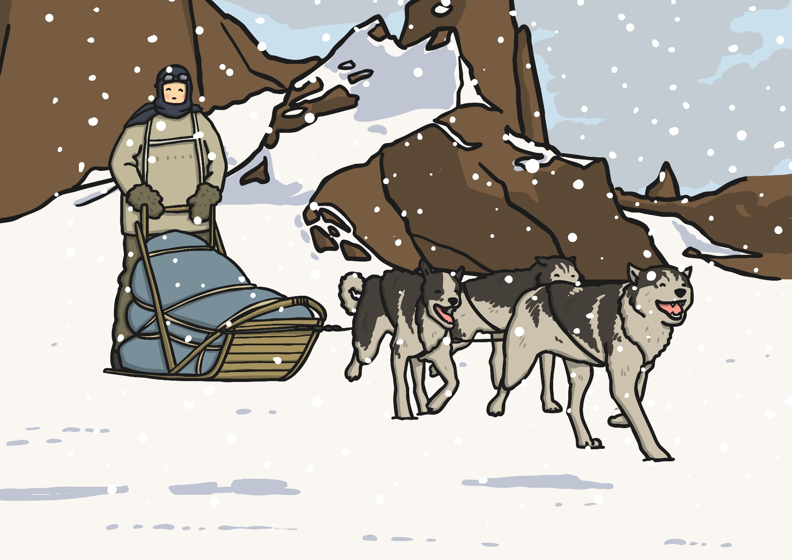
Scott and the men he travelled with had some sledge-dogs but the men mostly pulled the sledges by themselves, which was exhausting! They also struggled with frostbite and snow blindness.

Slide 11
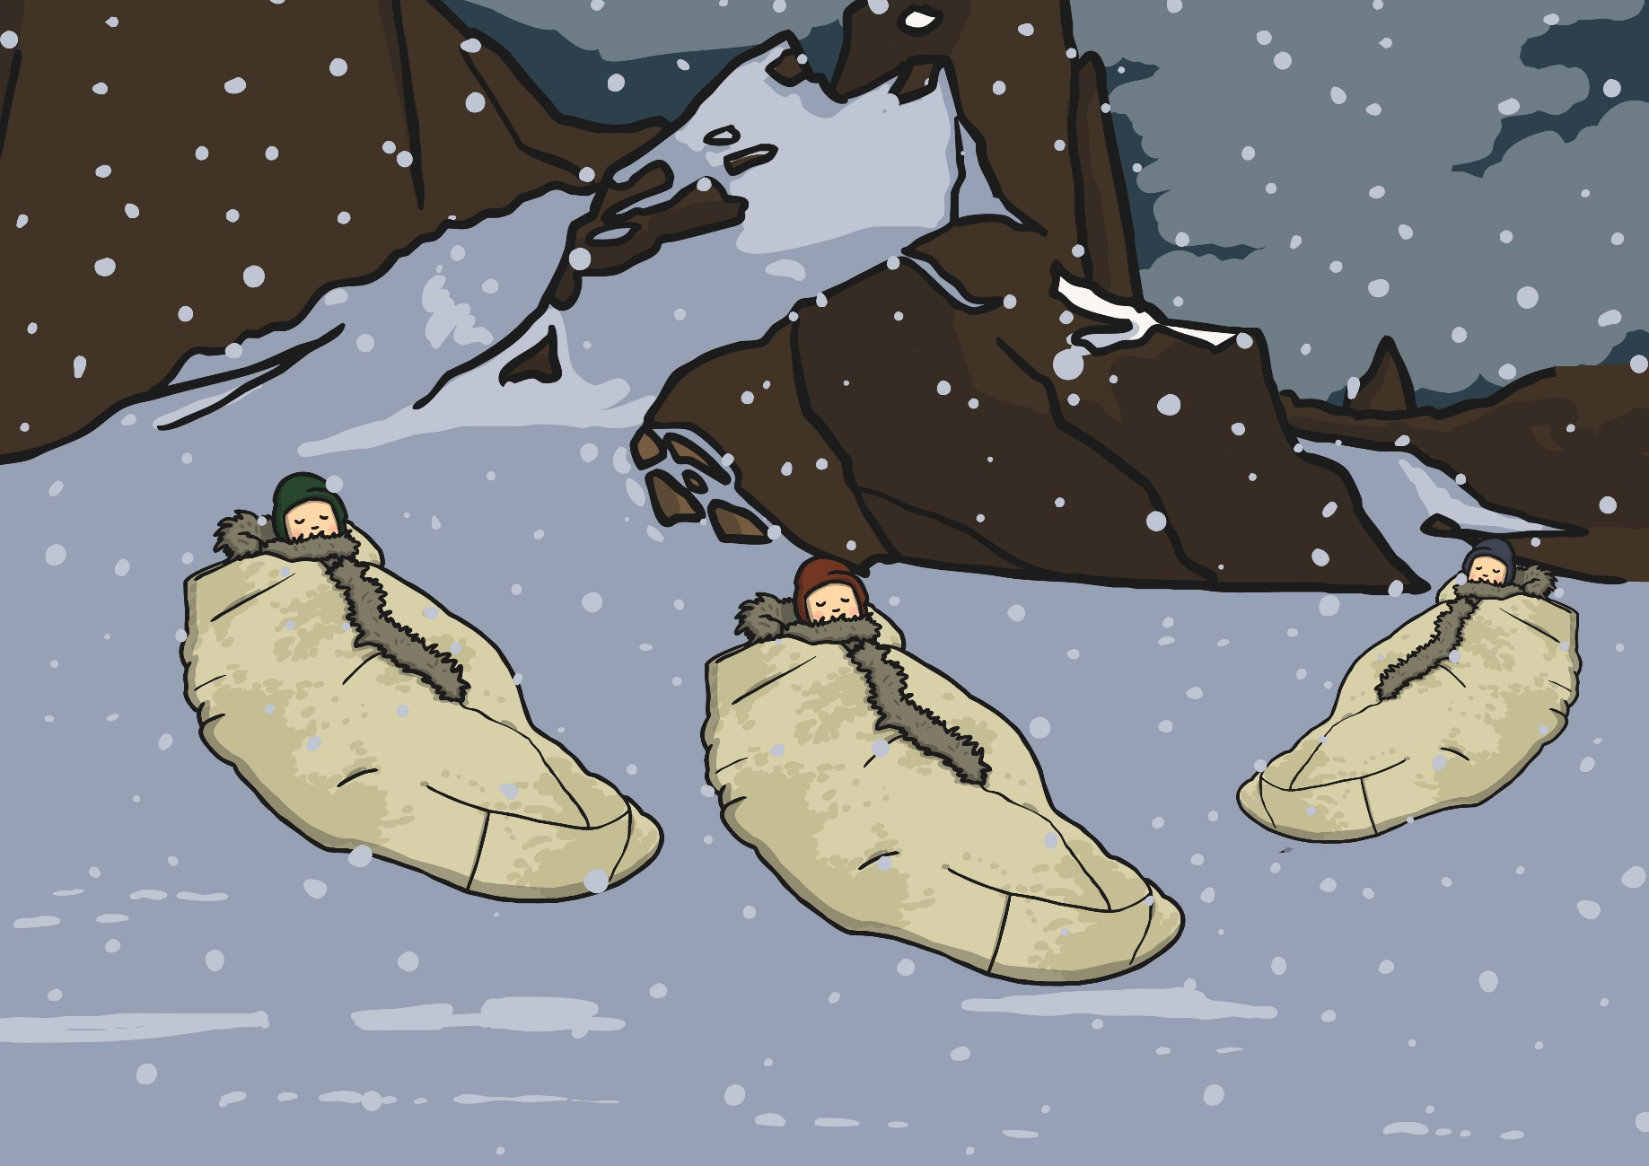
They slept in sleeping bags made from reindeer fur. However, they became wet and cold because the floors of their tents could not keep out the snow.

Slide 12
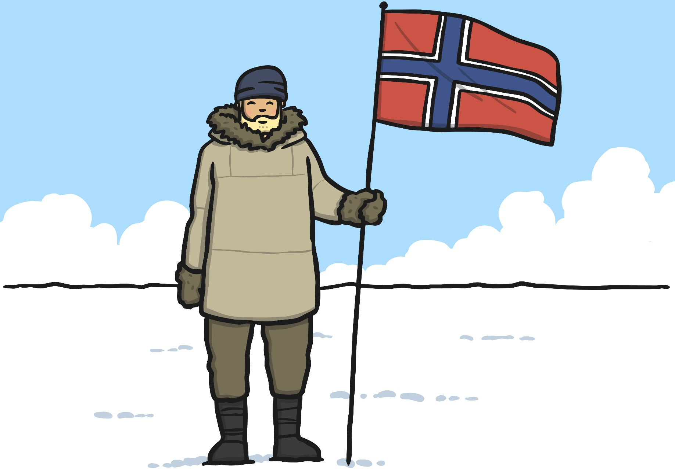
When they reached the South Pole on 17-18th January 1912, they discovered that a team of Norwegian explorers had arrived before them.

Slide 13
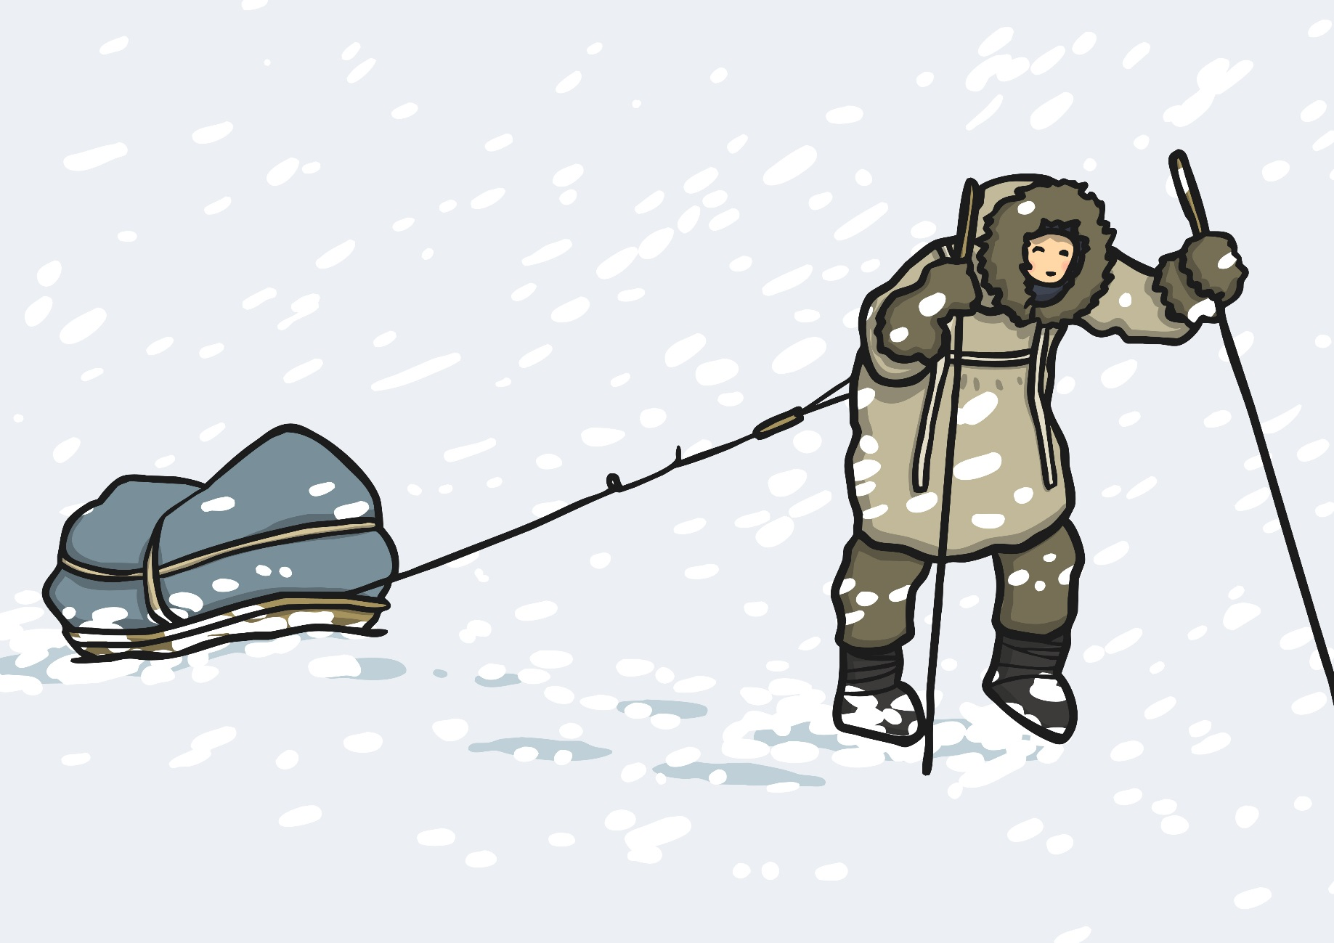
Scott and his companions had to travel back 800 miles through freezing temperatures and ice. They had a disastrous time with blizzards, gale force winds, poor clothing and little food.

Slide 14
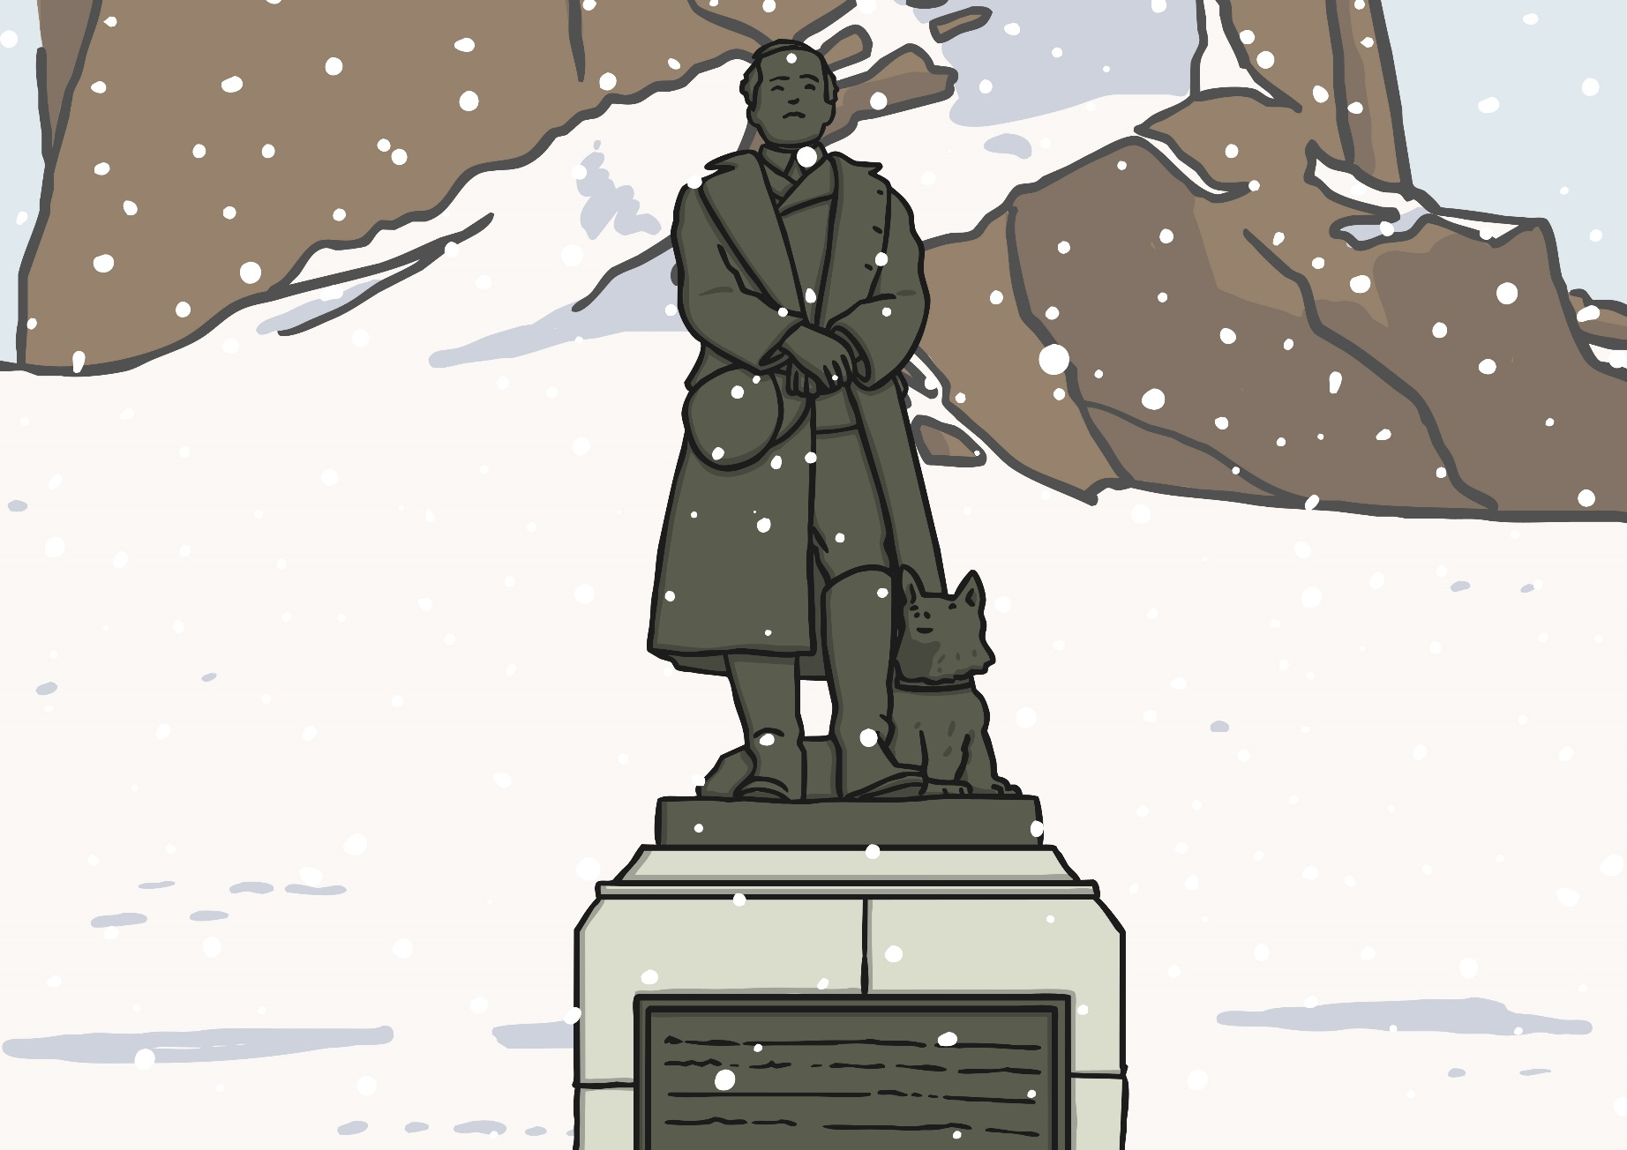
Eventually they all died. Many months later, a search party found their bodies, wrapped them in their tent and buried them in the snow.

Slide 15

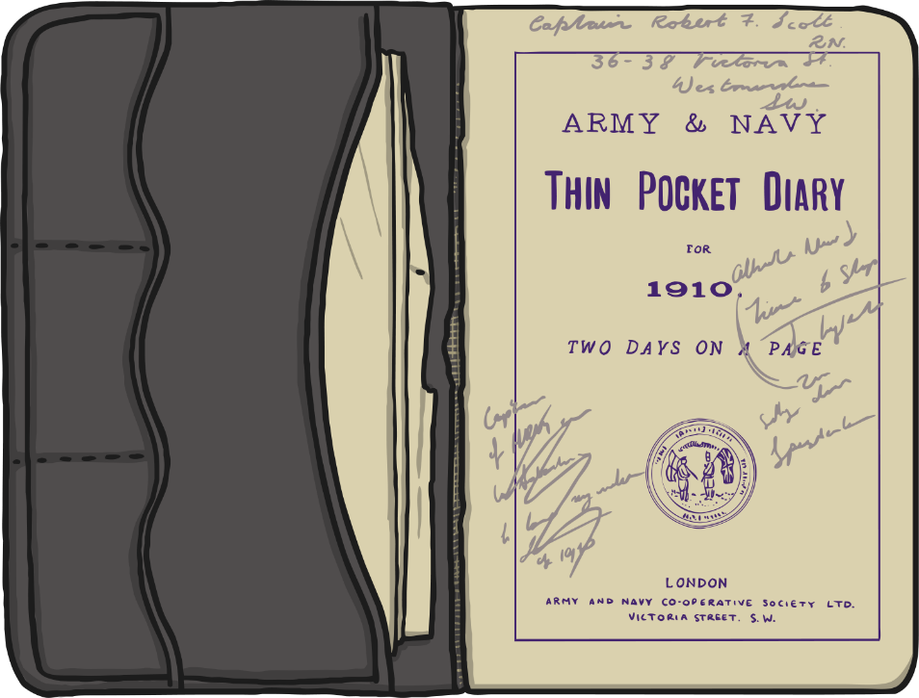
Scott’s Diary
Captain Scott kept a diary to record what was happening for the entire journey through the Antarctic.
What do you think he wrote on the journey back from the South Pole?
What was happening to him and his companions?

Slide 16
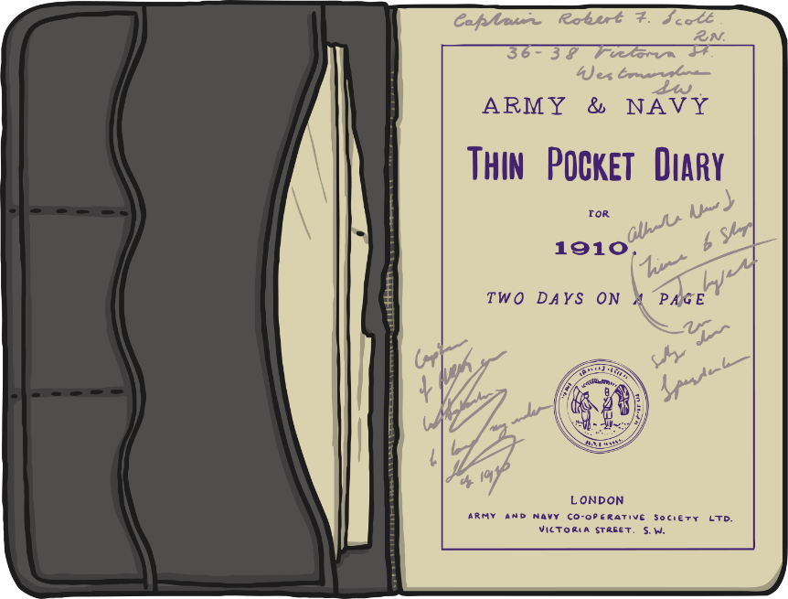
Your Diary Entries
What do you like about your partner’s diary entry?
What could be improved?
What have we learnt about Captain Scott?
Was his journey similar to the other explorers we have been learning about?

Slide 17

Aim
To find out about Captain Scott’s journey to the Antarctic.
Success Criteria
To think of reasons for and against Scott going to the Antarctic.
To write a diary entry from the point of view of Captain Scott on the journey back from the South Pole.

