Slide 1

Recognising Coins and Notes

Slide 2
Aim
I can identify and say the value of notes and coins.
Success Criteria
I can identify notes and coins.
I can say the value of notes and coins.

Slide 3

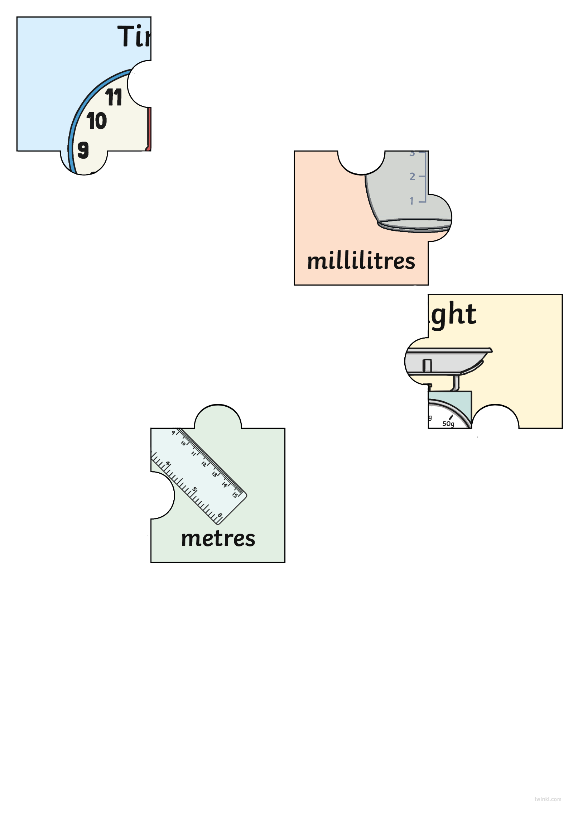
Jigsaw
Can you find the children who have the other pieces of your jigsaw?

Slide 4

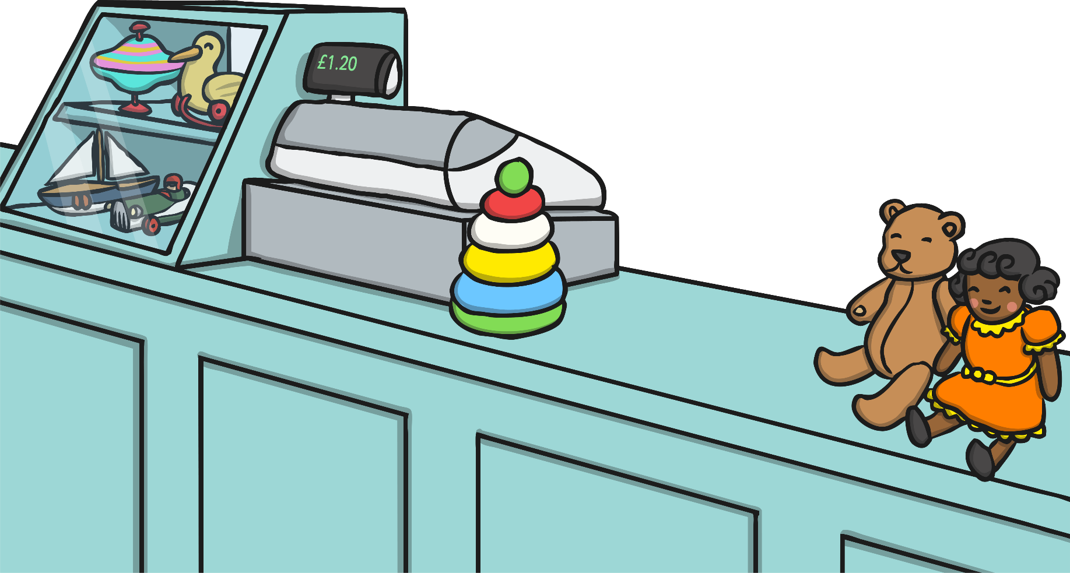
Coins and Notes
When we need to pay for things, we use money.
Money can be coins or notes.
In this country, our money is pounds and pence.
Each coin and note has a different value.
The number on the coin or note tells us its value.
The value of a coin or note is what it is worth.

Slide 5
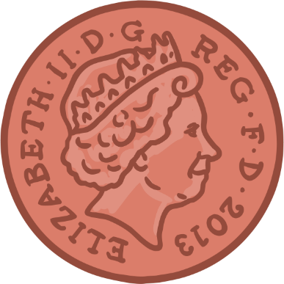
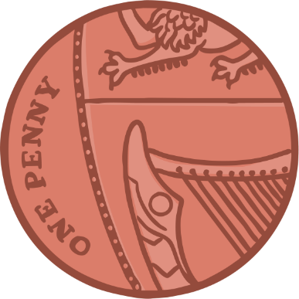
Coins and Notes
1p

Slide 6
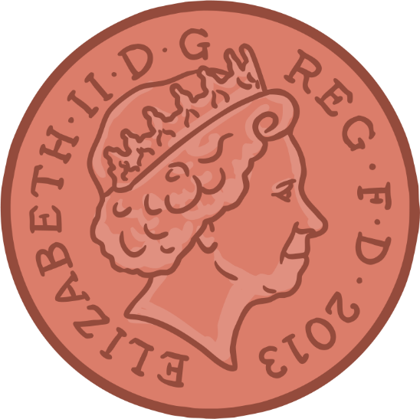

Coins and Notes
2p

Slide 7
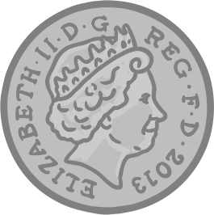
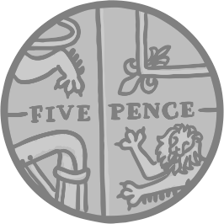
Coins and Notes
5p

Slide 8
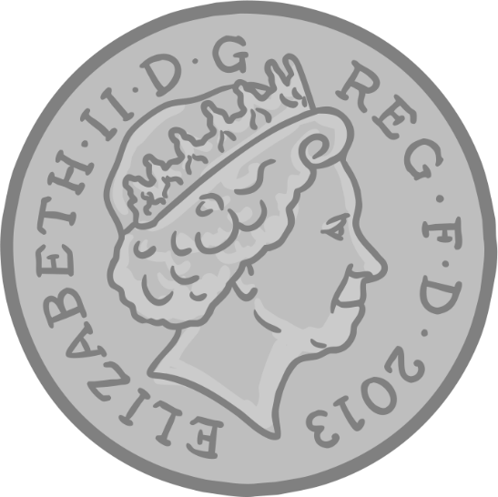

Coins and Notes
10p

Slide 9
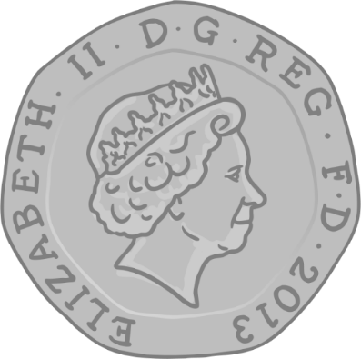
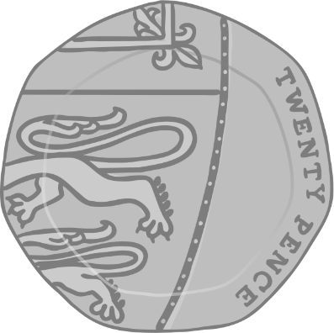
Coins and Notes
20p

Slide 10
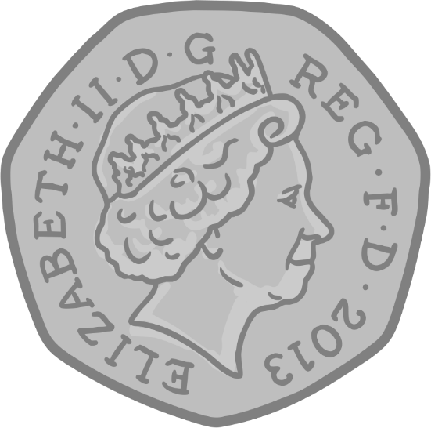
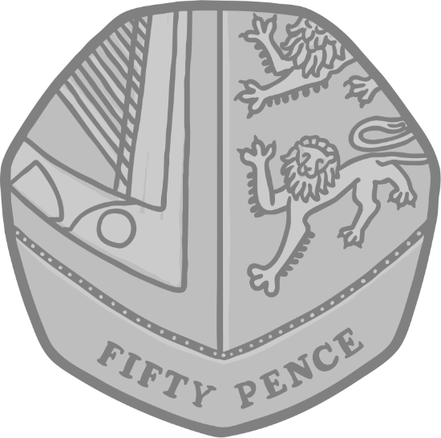
Coins and Notes
50p

Slide 11
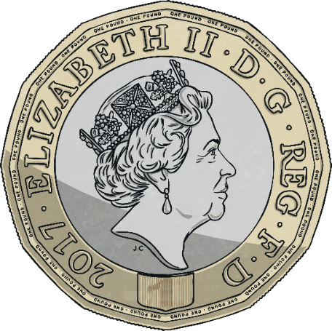
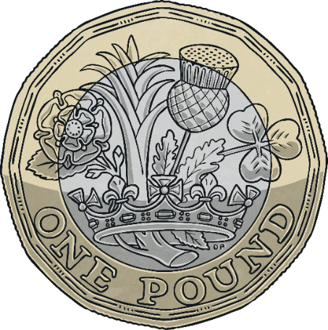
Coins and Notes
£1

Slide 12
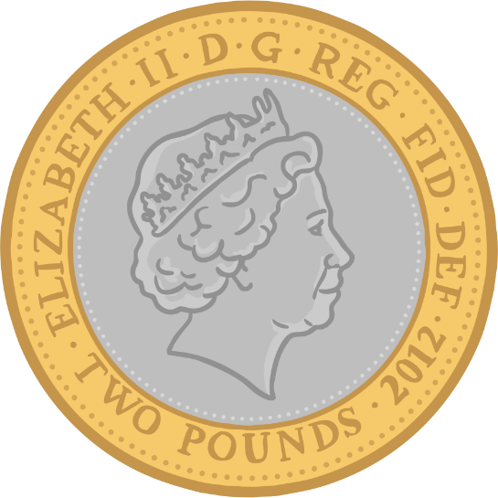
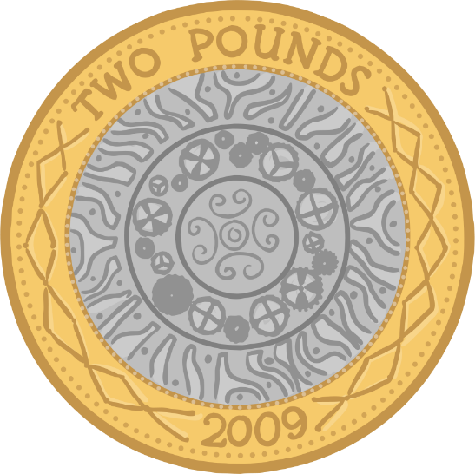
Coins and Notes
£2

Slide 13
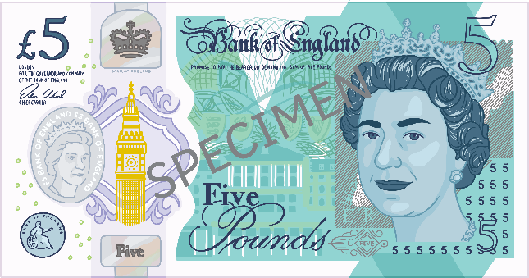
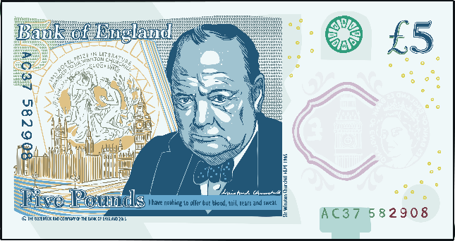
Coins and Notes
£5
SPECIMEN

Slide 14
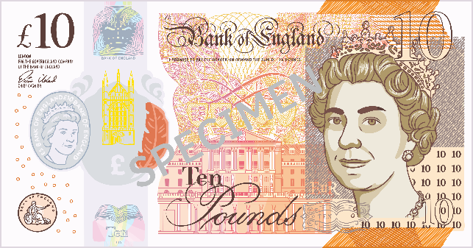
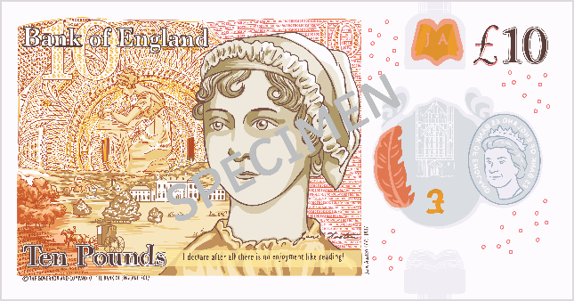
Coins and Notes
£10

Slide 15
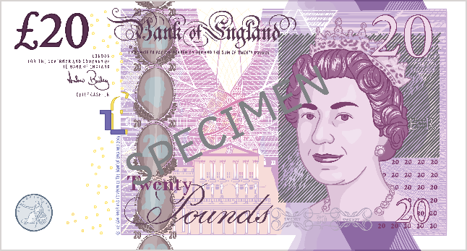
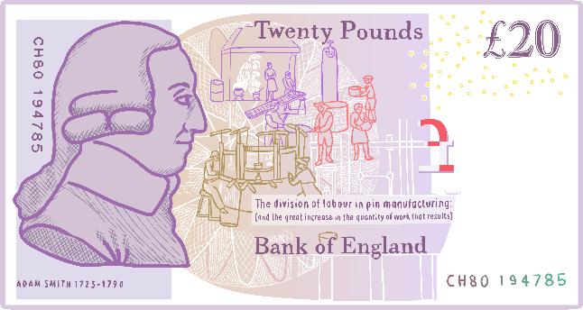
Coins and Notes
£20
SPECIMEN

Slide 16

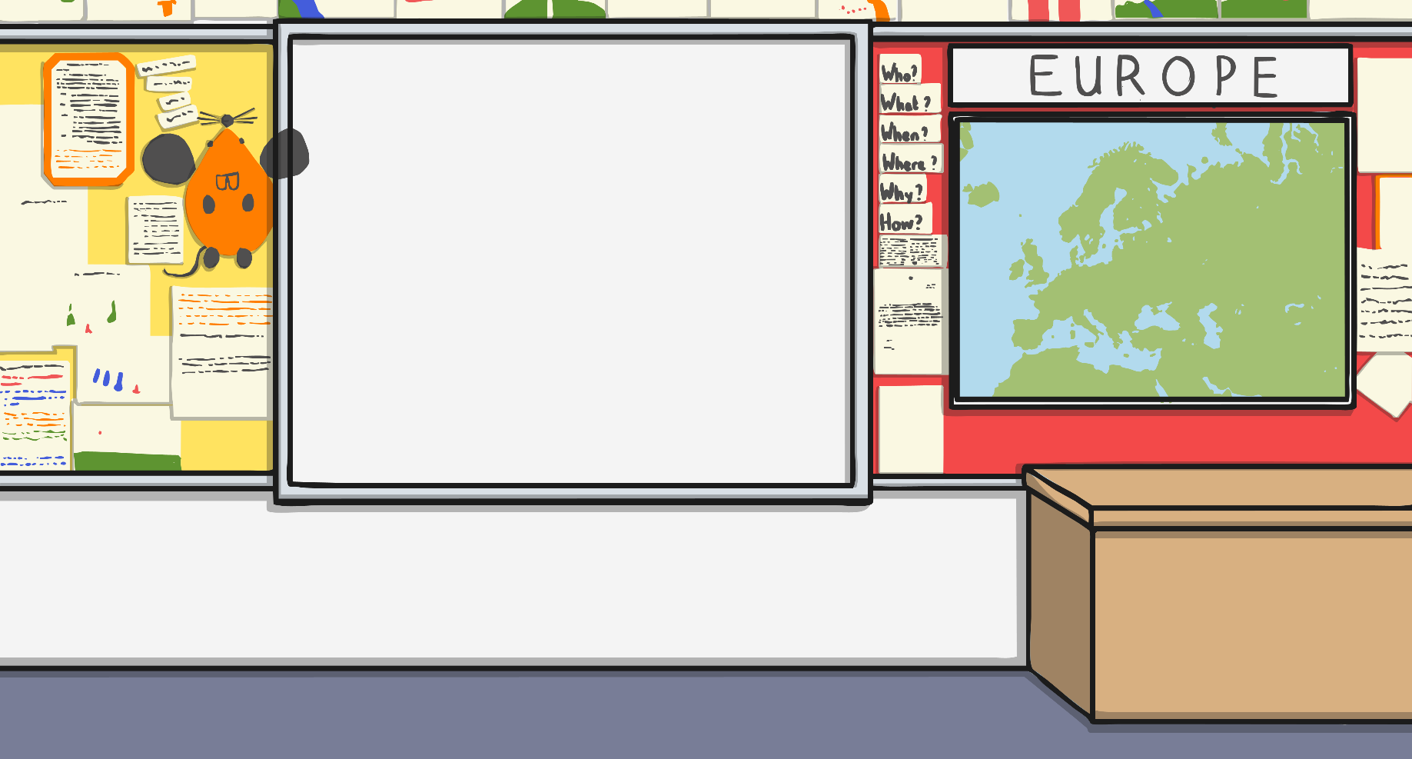
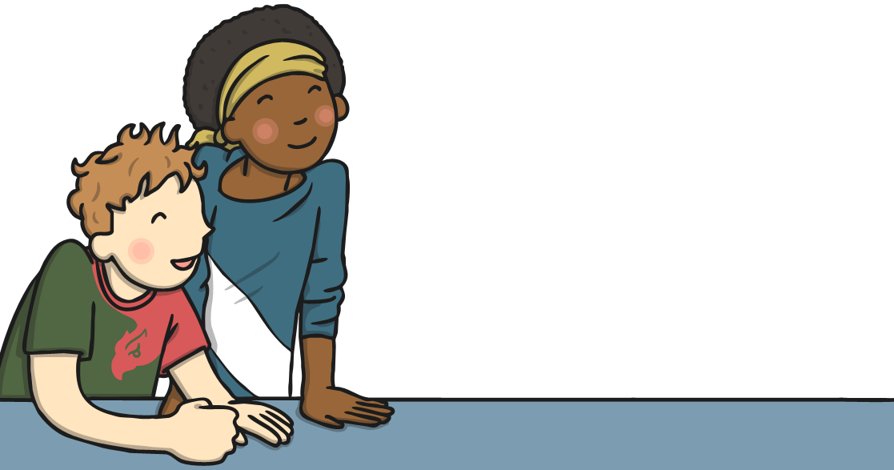

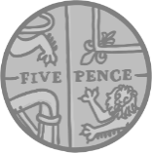


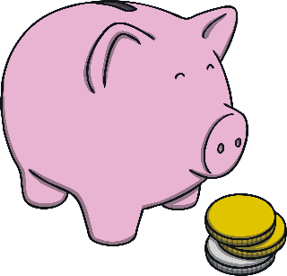
Which Coin?
Which coin am I pointing to? Write it down on your whiteboard.

Slide 17
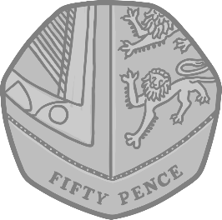
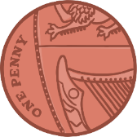
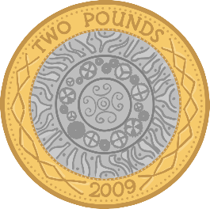
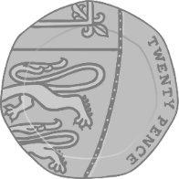
Which Coin?
Which coin am I pointing to? Write it down on your whiteboard.

Slide 18
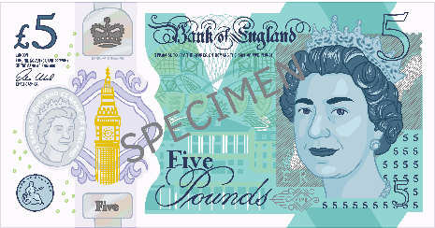
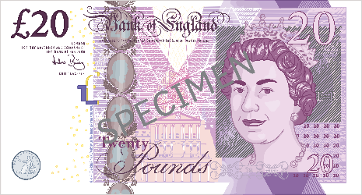
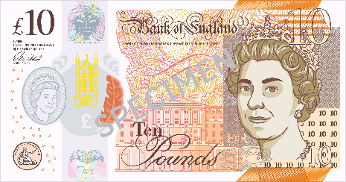
Which Coin?
Which note am I pointing to? Write it down on your whiteboard.

Slide 19




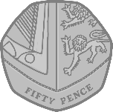
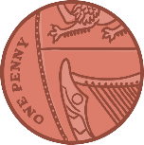
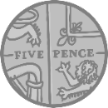
Pounds or Pence?
Some coins are worth pence and some coins are worth pounds.
This is the sign for pence:
p
Pence are small amounts of money.
These coins are worth pence (p).

Slide 20

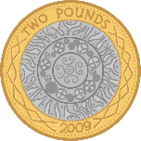
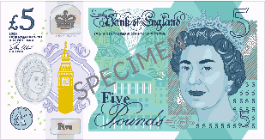
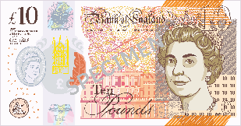
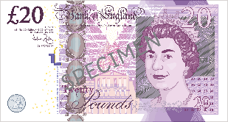
Pounds or Pence?
Some coins are worth pence and some coins are worth pounds.
This is the sign for pounds:
£
Notes are always worth pounds.
Pounds are bigger amounts of money.
These coins and notes are worth pounds (£).

Slide 21

Pounds or Pence?
Is this coin worth pounds or pence?
pounds
(£)
pence
(p)

Slide 22

Pounds or Pence?
Is this coin worth pounds or pence?
pounds
(£)
pence
(p)

Slide 23
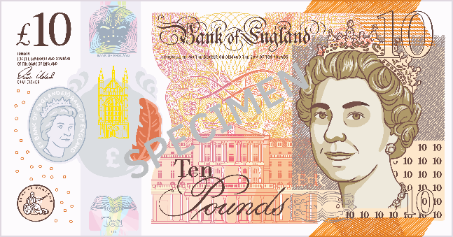
Pounds or Pence?
Is this coin worth pounds or pence?
pounds
(£)
pence
(p)

Slide 24

Pounds or Pence?
Is this coin worth pounds or pence?
pounds
(£)
pence
(p)

Slide 25
Pounds or Pence?
Is this coin worth pounds or pence?
pounds
(£)
pence
(p)

Slide 26
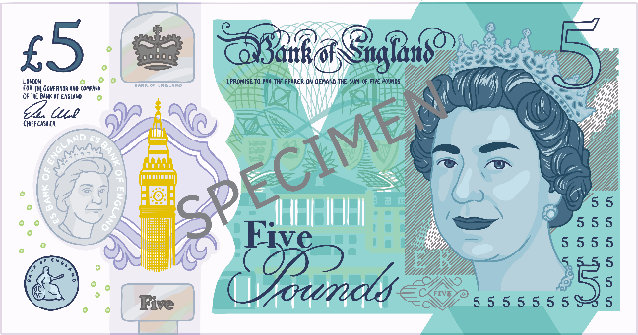
Pounds or Pence?
Is this coin worth pounds or pence?
pounds
(£)
pence
(p)

Slide 27
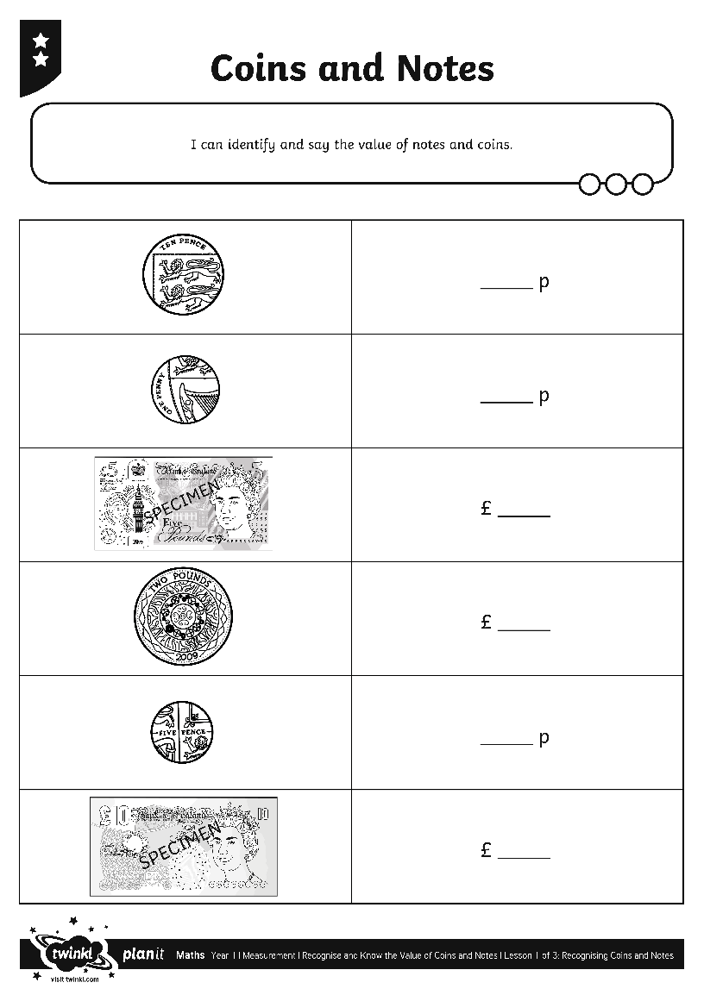
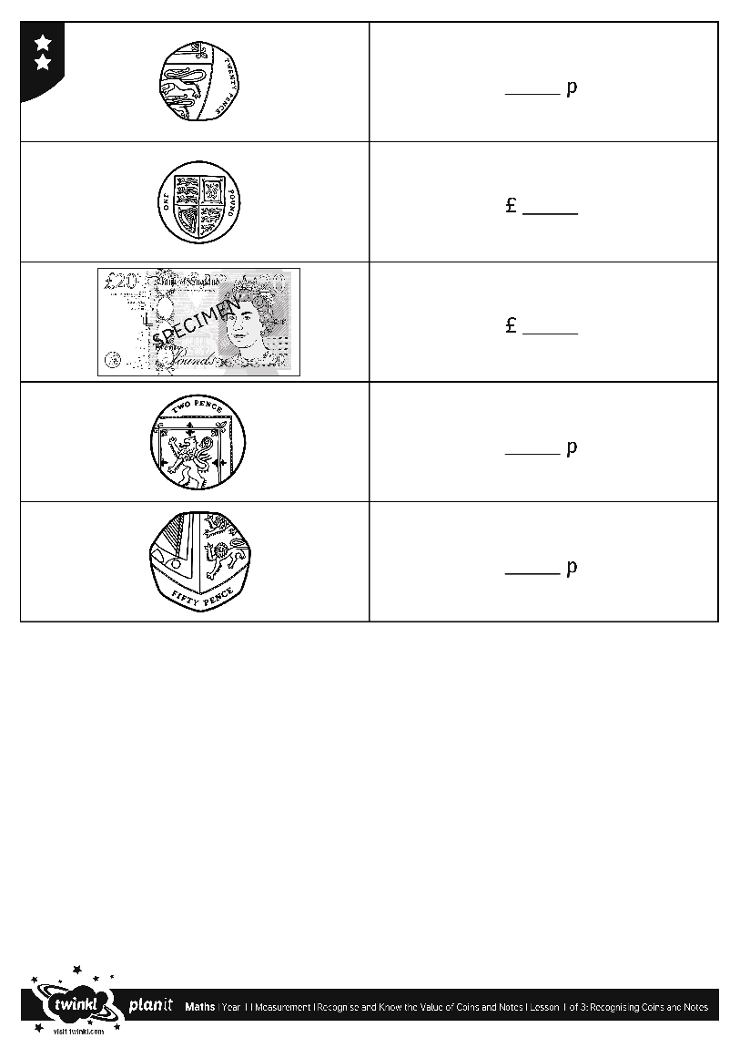
Coins and Notes Activities

Slide 28
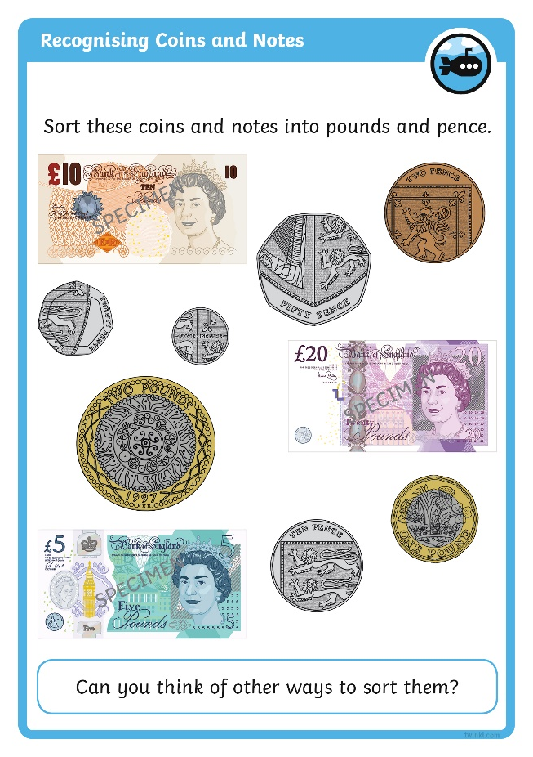
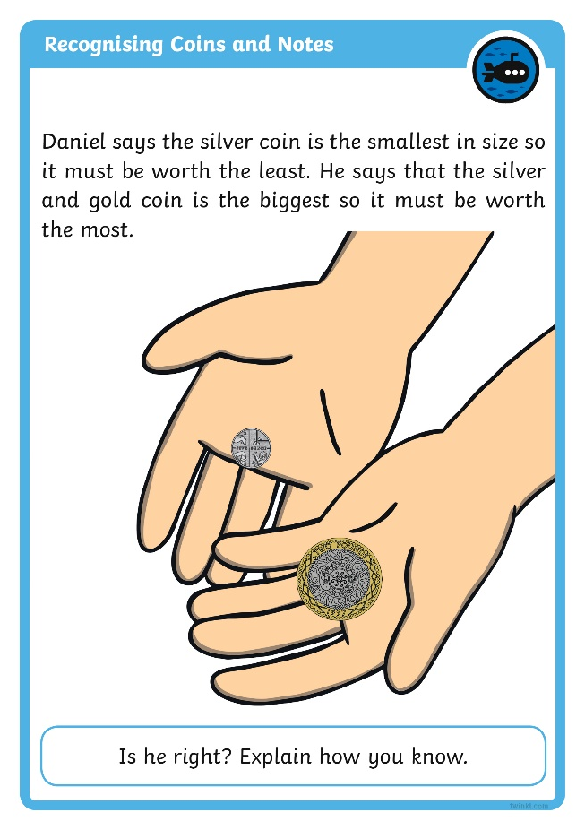

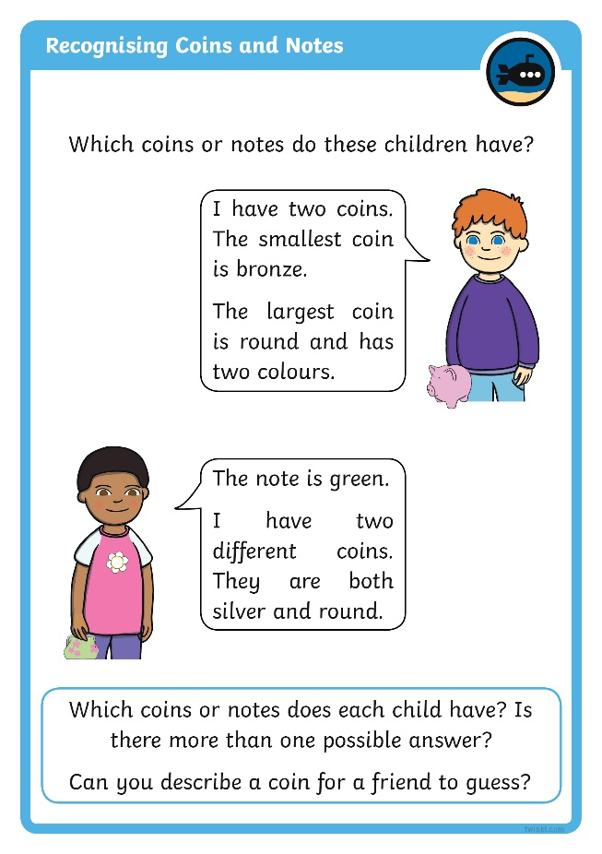
Diving into Mastery
Dive in by completing your own activity!

Slide 29
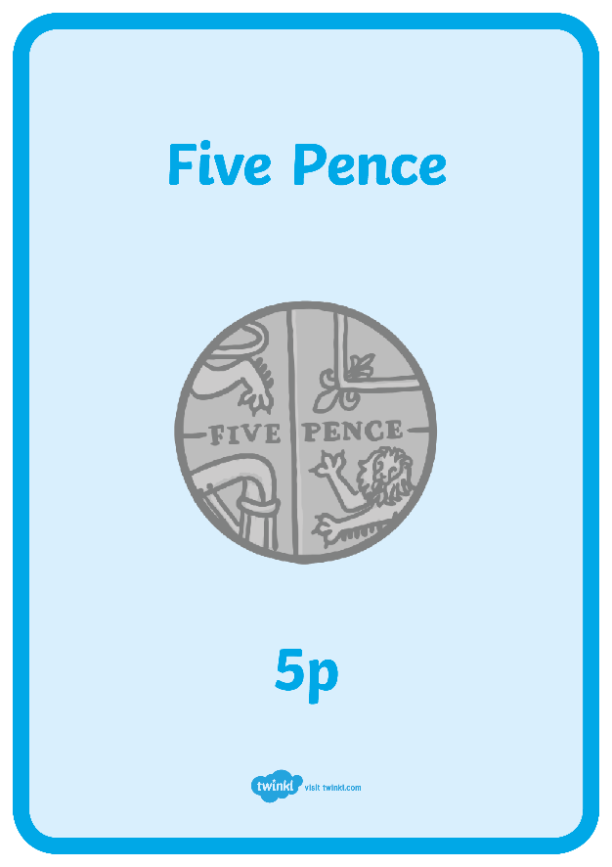
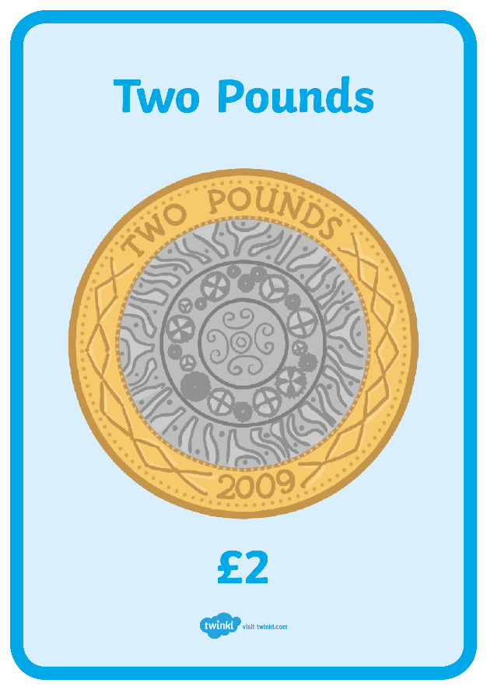
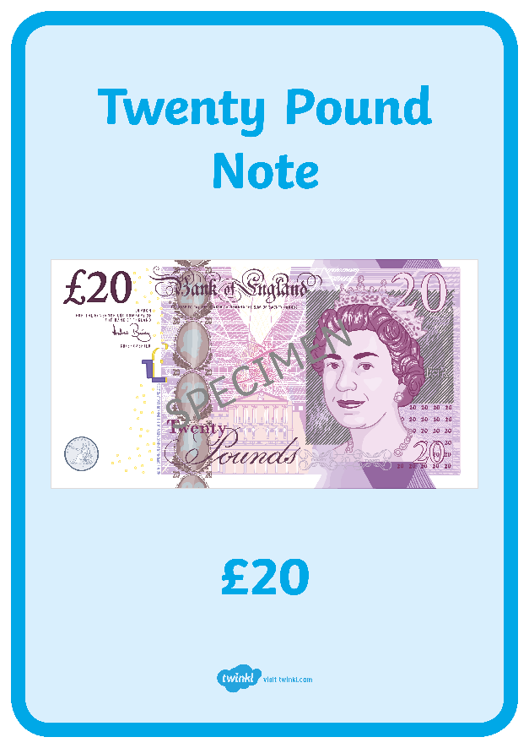
Money Run
Find a partner. Look at the posters around the classroom.
I will shout out a coin or note. You need to move to the correct poster.

Slide 30
Aim
I can identify and say the value of notes and coins.
Success Criteria
I can identify notes and coins.
I can say the value of notes and coins.

Slide 31


