Slide 2


Meet the 3D shapes
Here is a cube.
?
What can you tell me about this shape?
?
Can you find this shape in the classroom?

Slide 3

Meet the 3D shapes
Here is a cuboid.
?
What can you tell me about this shape?
?
Can you find this shape in the classroom?

Slide 4

Meet the 3D shapes
Here is a cone.
?
What can you tell me about this shape?
?
Can you find this shape in the classroom?

Slide 5
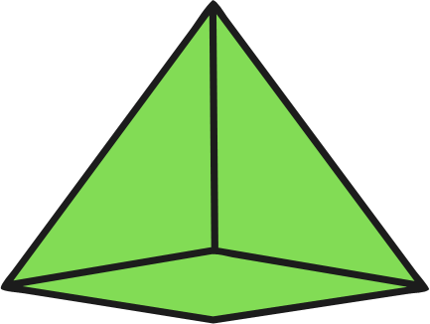
Meet the 3D shapes
Here is a pyramid.
?
What can you tell me about this shape?
?
Can you find this shape in the classroom?

Slide 6

Meet the 3D shapes
Here is a cylinder.
?
What can you tell me about this shape?
?
Can you find this shape in the classroom?

Slide 7

Meet the 3D shapes
Here is a sphere.
?
What can you tell me about this shape?
?
Can you find this shape in the classroom?

Slide 8


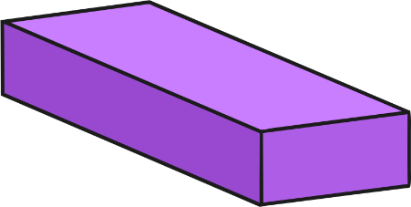


Meet the 3D shapes
Can you remember their names?
Click on the shape to check.
cube
cuboid
cone
pyramid
cylinder
sphere

Slide 9

Meet the 3D Shapes
3D shapes have three dimensions which means they are not flat like 2D shapes.
They can be seen all the way around.

Slide 10

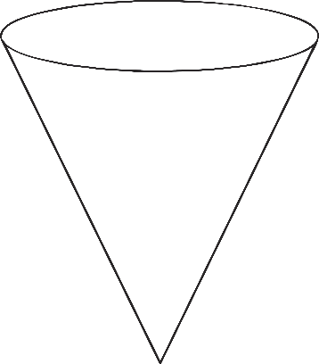
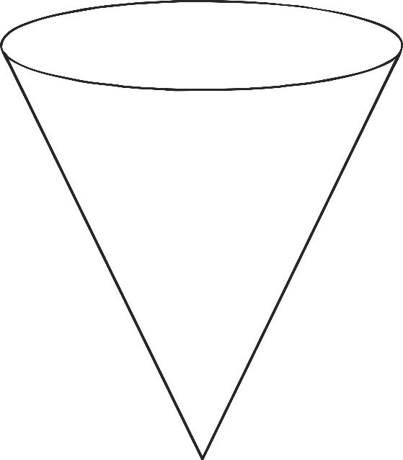
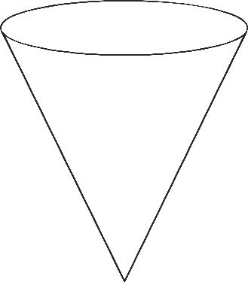
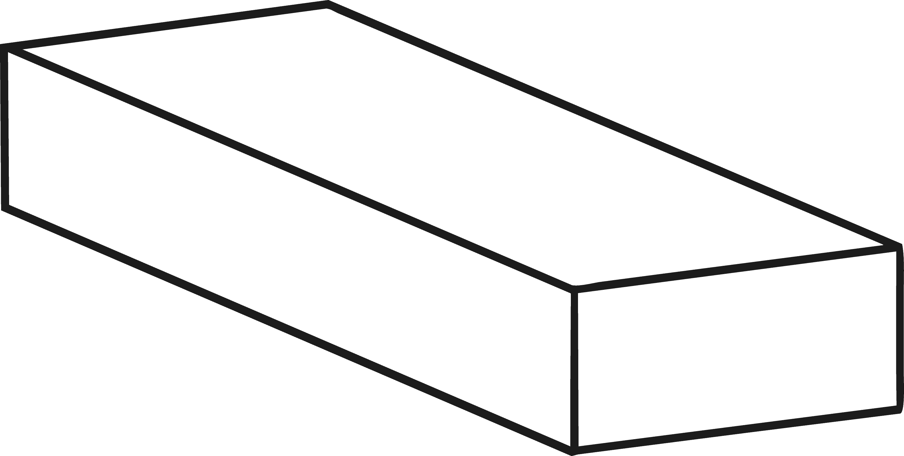
Odd One Out
Which of these shapes is the odd one out?
Can you explain why?

Slide 11

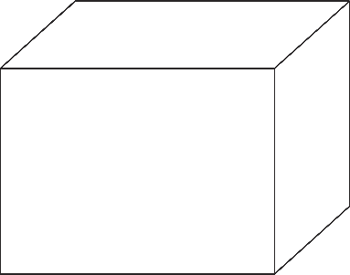

Odd One Out
Which of these shapes is the odd one out?
Can you explain why?

Slide 12
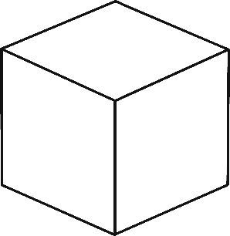
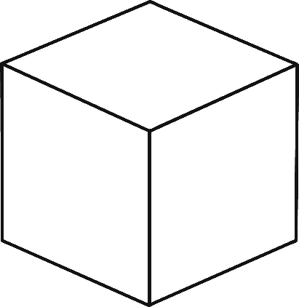
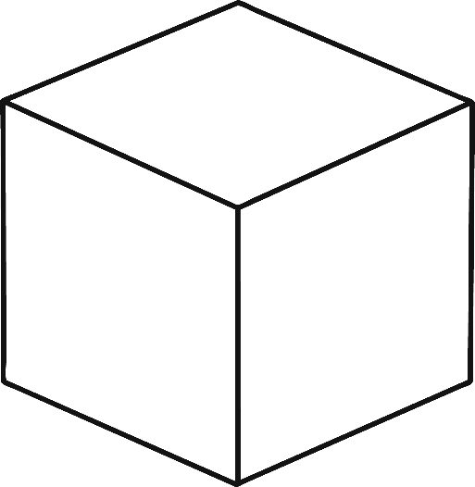

Odd One Out
Which of these shapes is the odd one out?
Can you explain why?

Slide 13
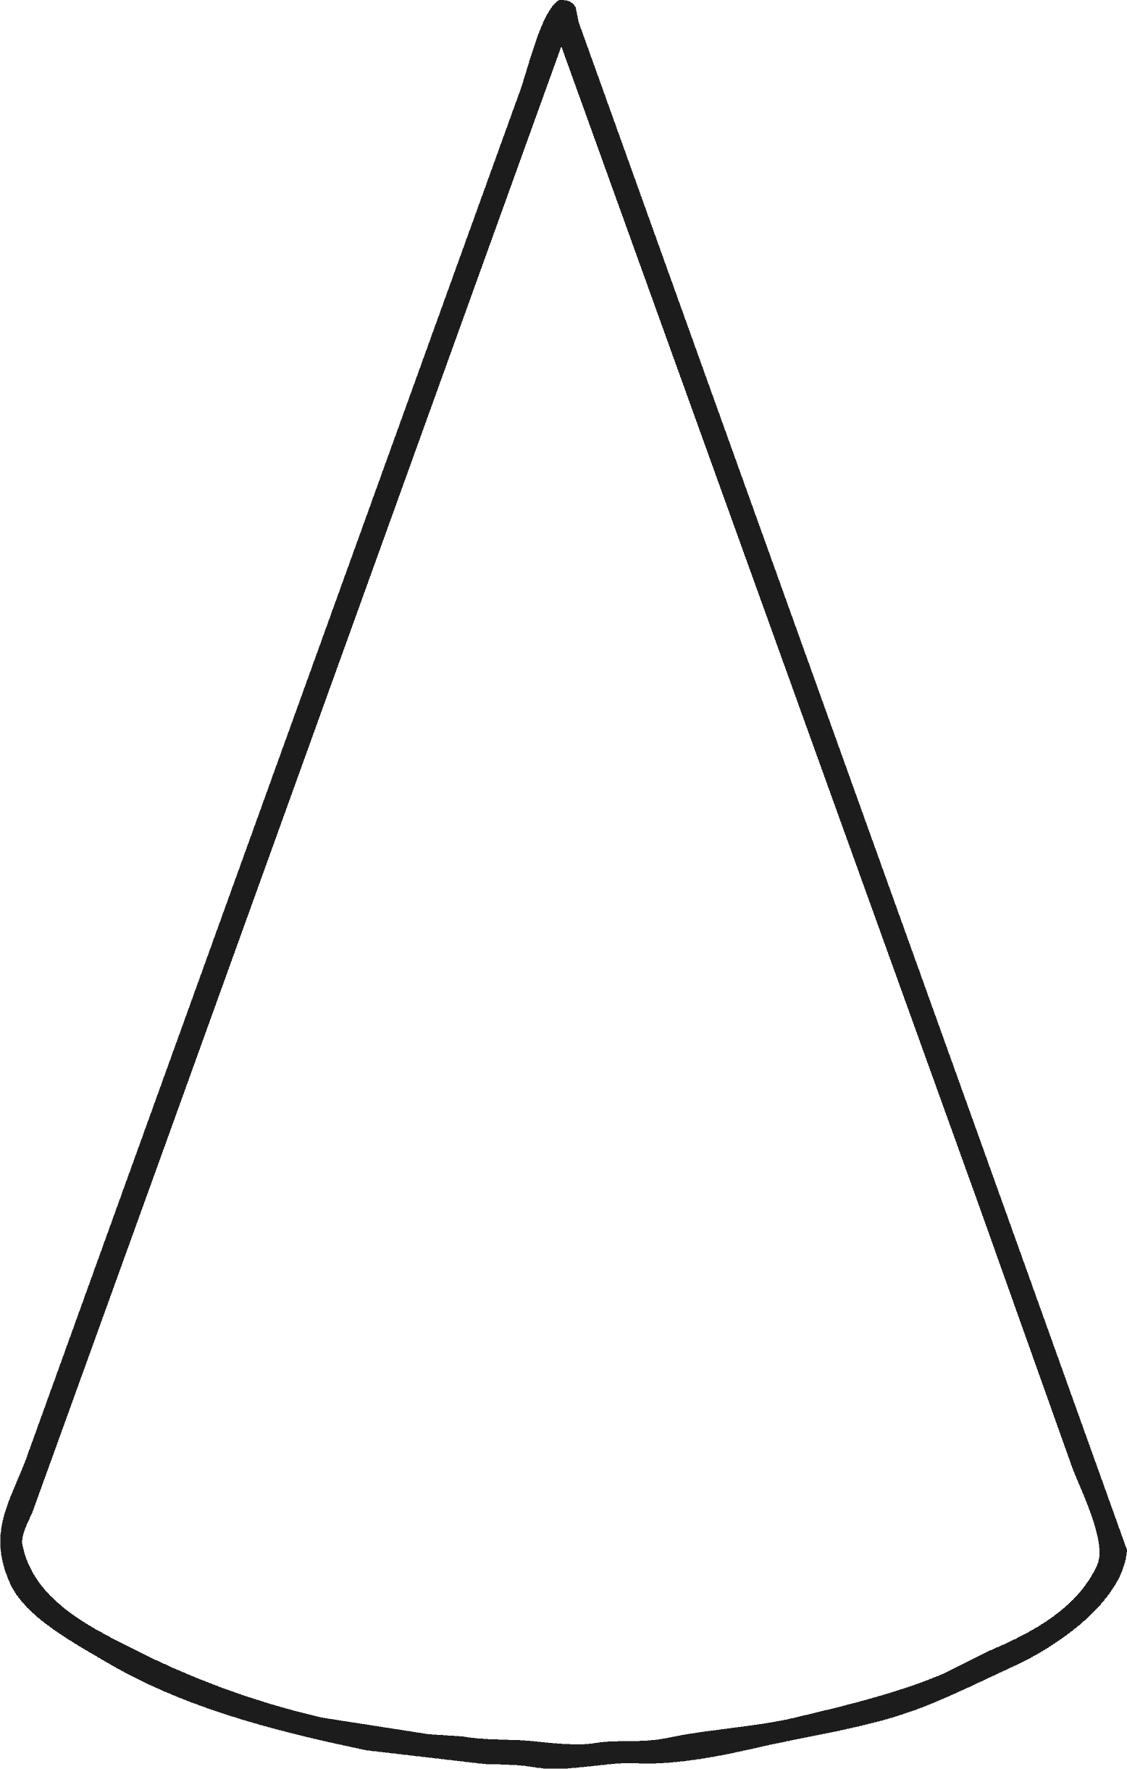

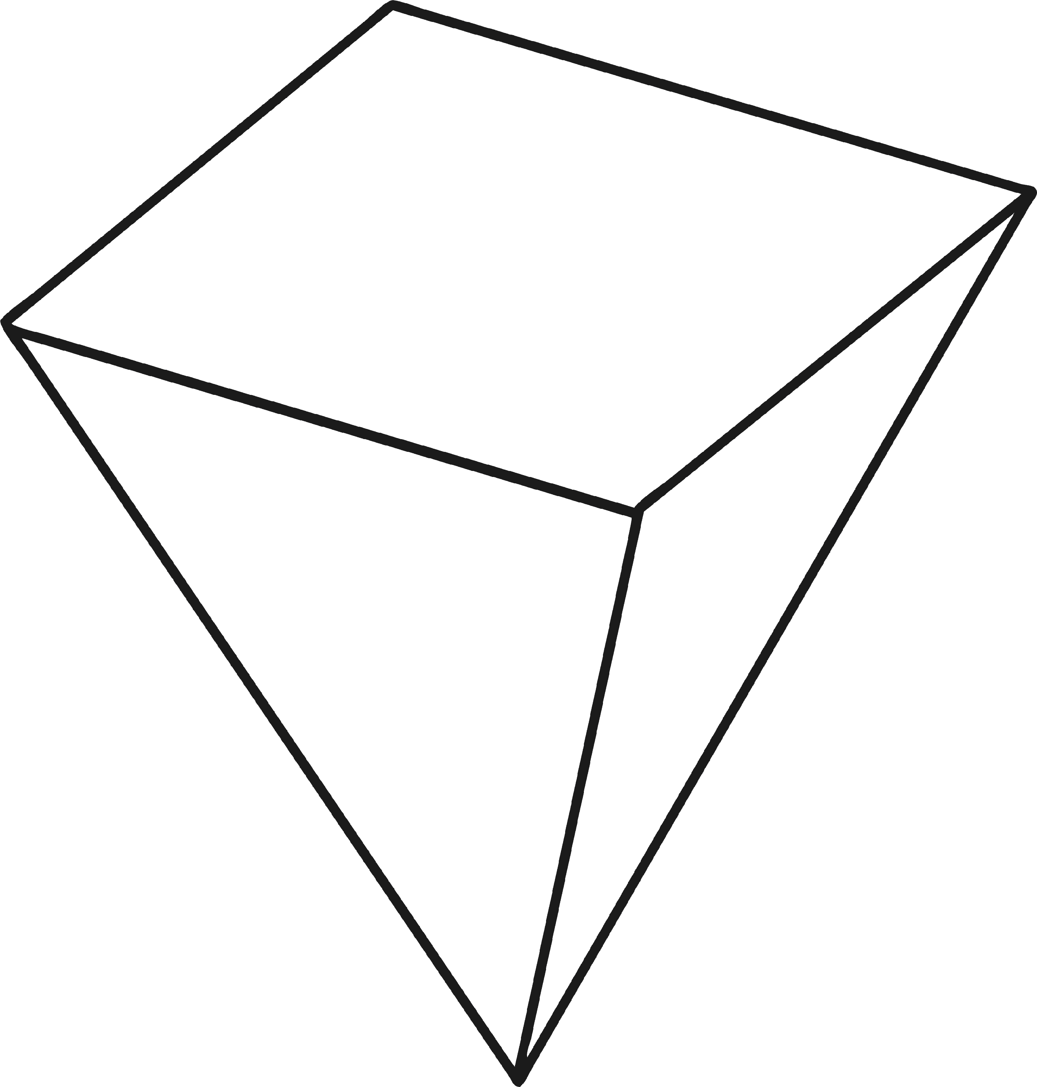
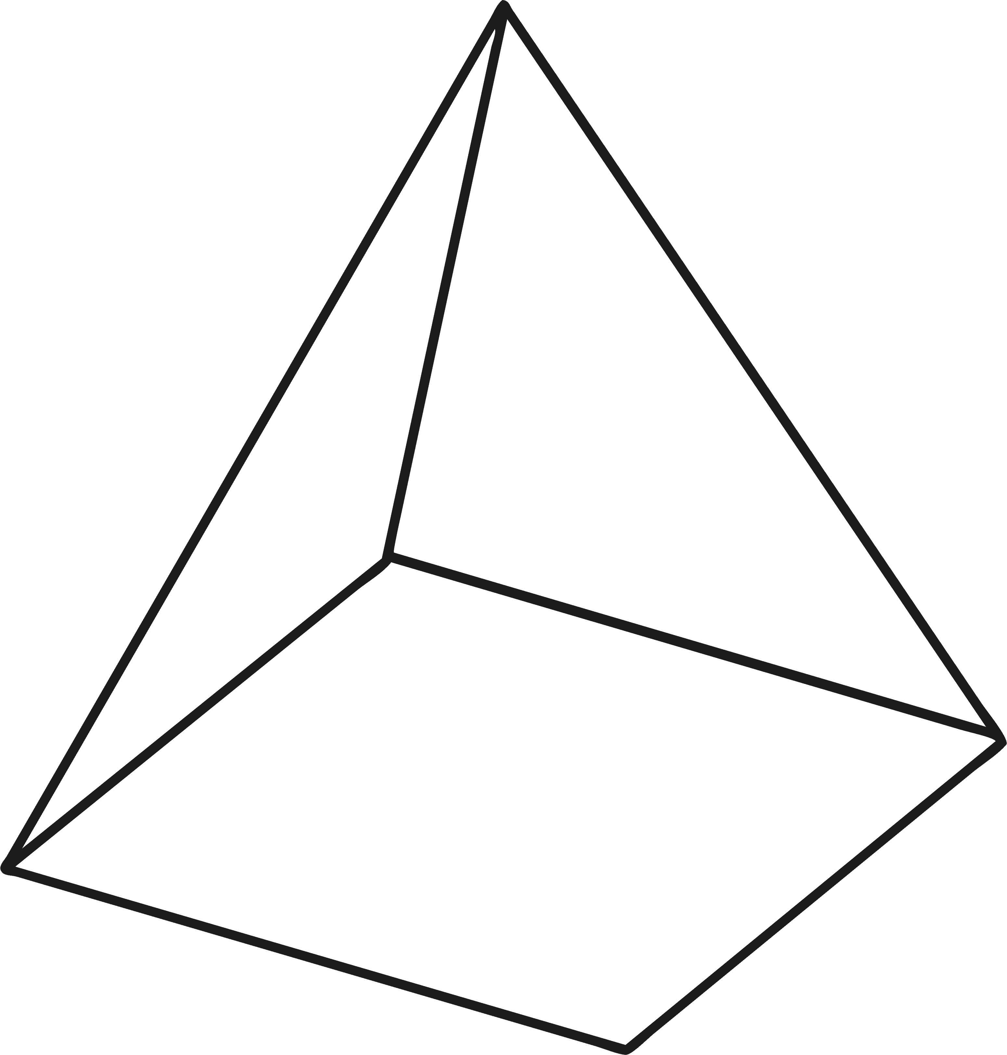
Odd One Out
Which of these shapes is the odd one out?
Can you explain why?

Slide 14
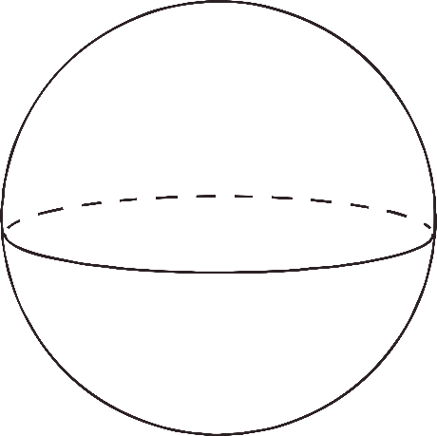
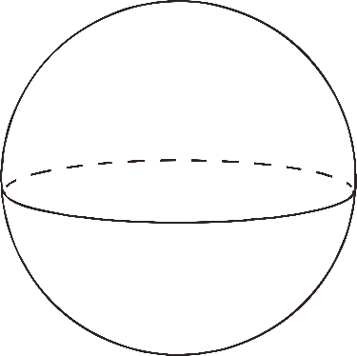
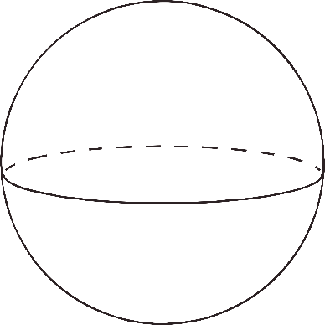
Odd One Out
Which of these shapes is the odd one out?
Can you explain why?

Slide 15
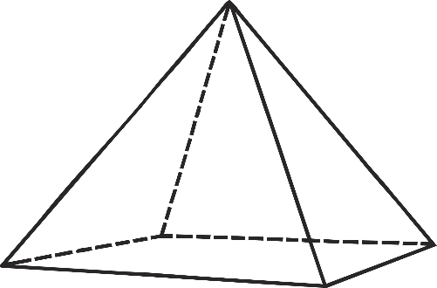
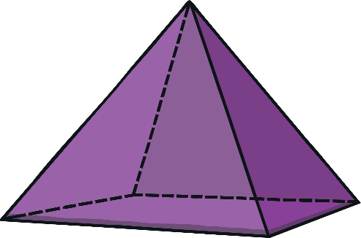
Odd One Out
Which of these shapes is the odd one out?
Can you explain why?

