Slide 1
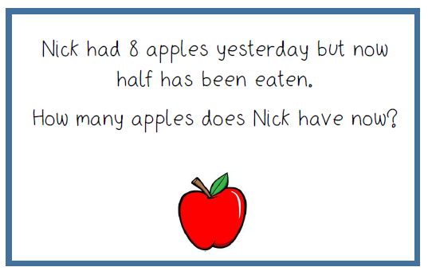
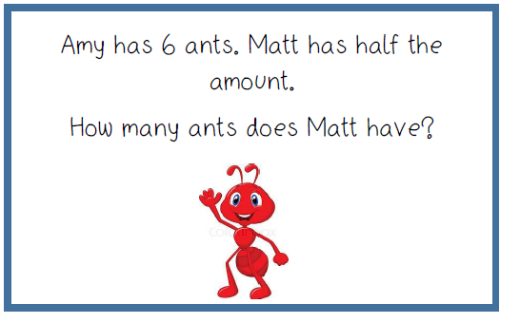
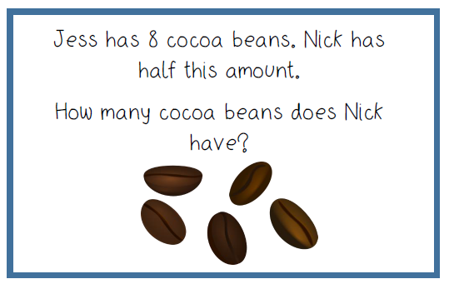
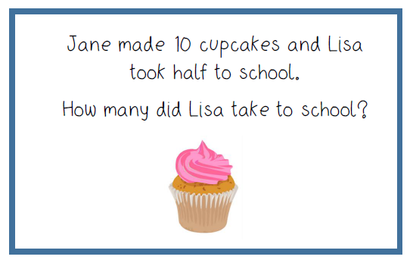
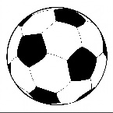
I can identify and represent numbers using objects. I can solve one step problems involving multiplication by using concrete objects. I can solve one step problems involving multiplication by pictorial representation.
Halving
Show me your working out.
½ of 8 is
½ of is
Martin has 12 balls. He gives half to his friend Max.
How many does Max have?

