Slide 1
10
4
8
2
6
14

Slide 2

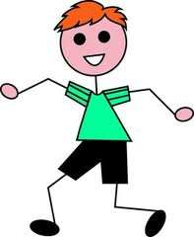

10
4
Imagine that you are sharing a pizza between 2 people.
You would need to cut the pizza in half.
Each person would then have exactly the same amount of pizza.
14
6

Slide 3
10
4
8
Let’s try and find half of the number 6 . We can use objects to help us.
We need to share the 6 circles into 2 equal piles and count how many is in each half.
So half of 6 is

Slide 4
10
4
8
Now let’s try and find half of the number 8 . We need to share the 8 circles into 2 equal piles and count how many is in each half.
So half of 8 is

Slide 5
4
8
Can you find half of the number 10?
So half of 10 is

Slide 6
10
4
8
Can you find half of the number 14 ?
So half of 14 is

Slide 7
10
4
8
What is half of the number 11 ?

Slide 8

4
8
That’s right odd numbers can’t be halved !
Also remember to check your answers carefully if each halve has a different amount you haven’t halved the number correctly!

