Slide 2
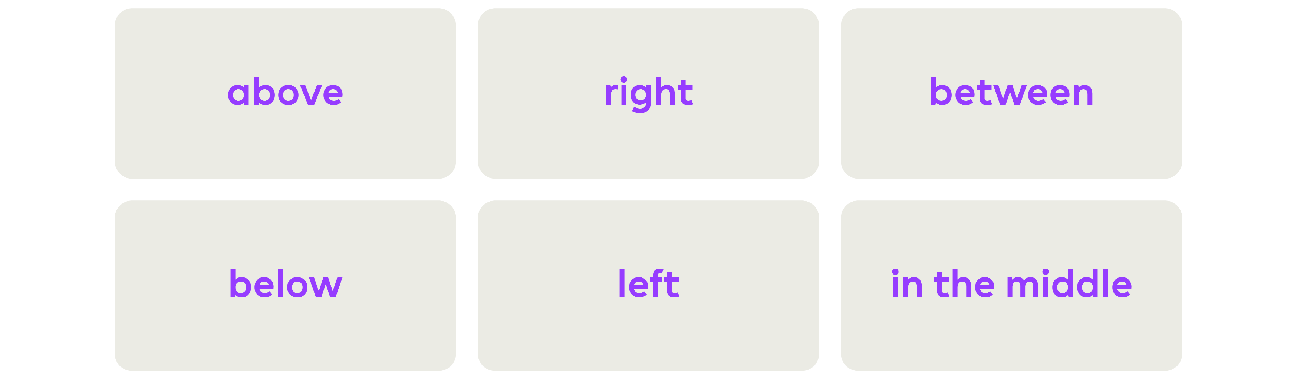
Position
In the following activities we’re going to practice using some important language we use to describe where things are.
Key words:

Slide 3
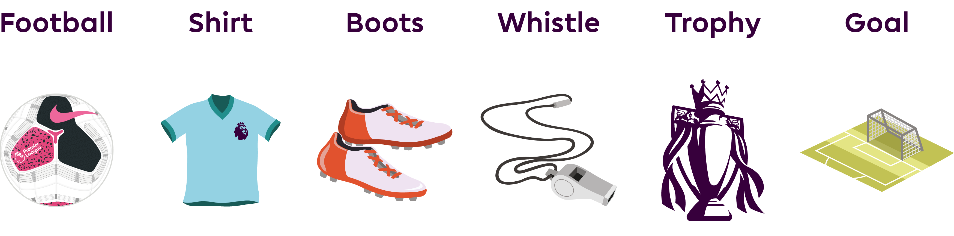
Position
You will be asked to describe the position of some objects you might associate to football.

Slide 4
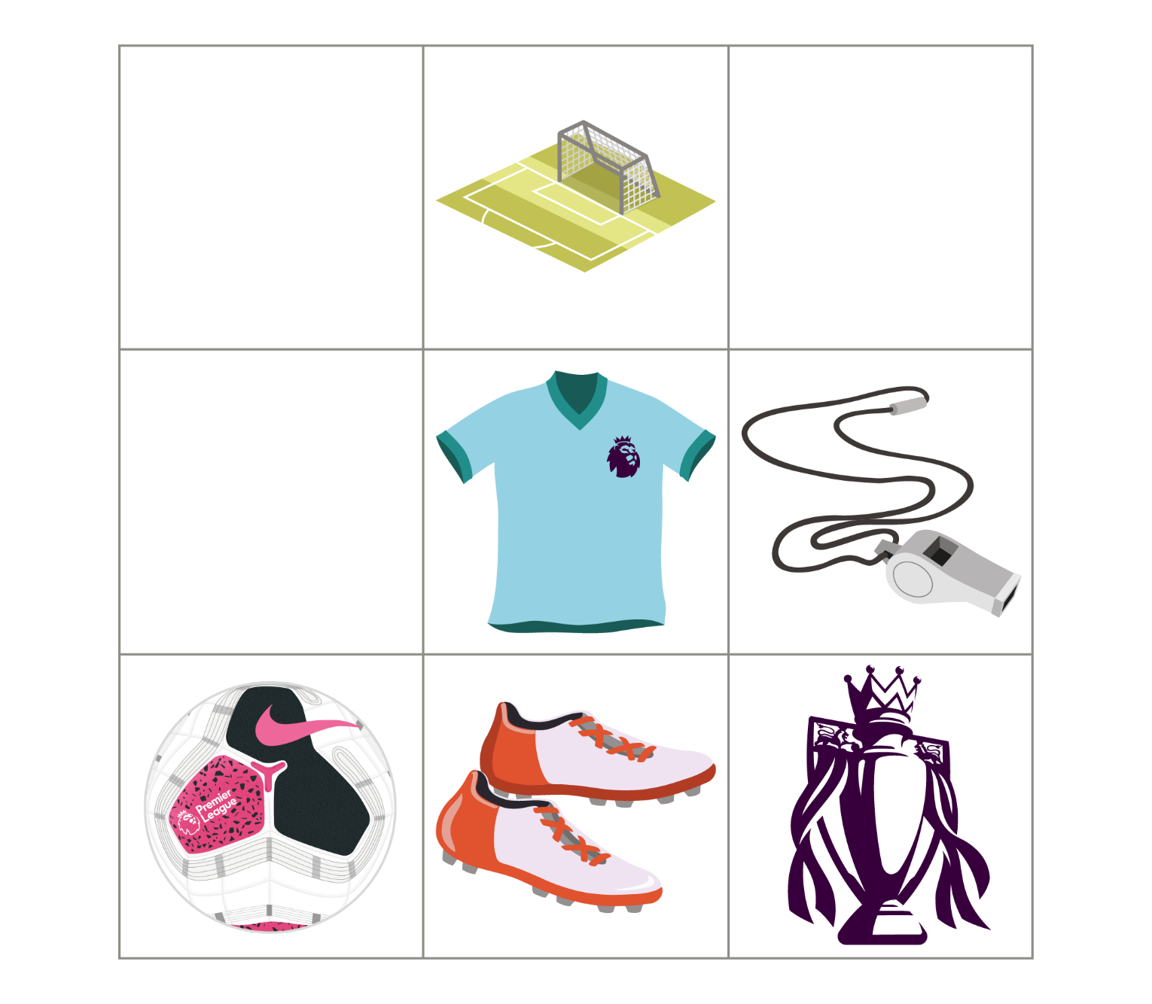
Let’s practise describing position together.
The goal is above the shirt
The _______ is below the whistle
The football is to the left of the boots
The _______ is to the right of the shirt
The _______ is in the middle of the grid.
The _______ is between football and the trophy.

Slide 5
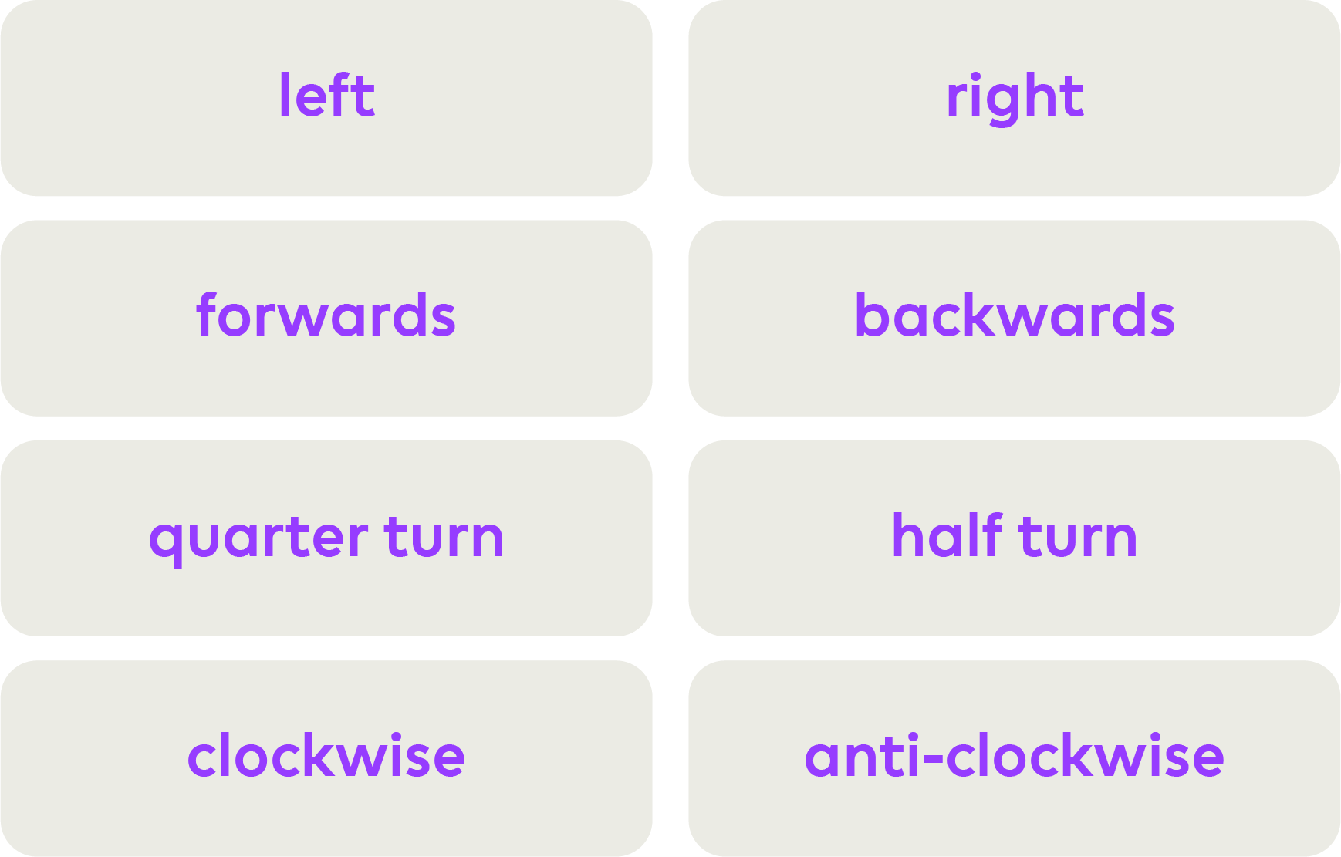
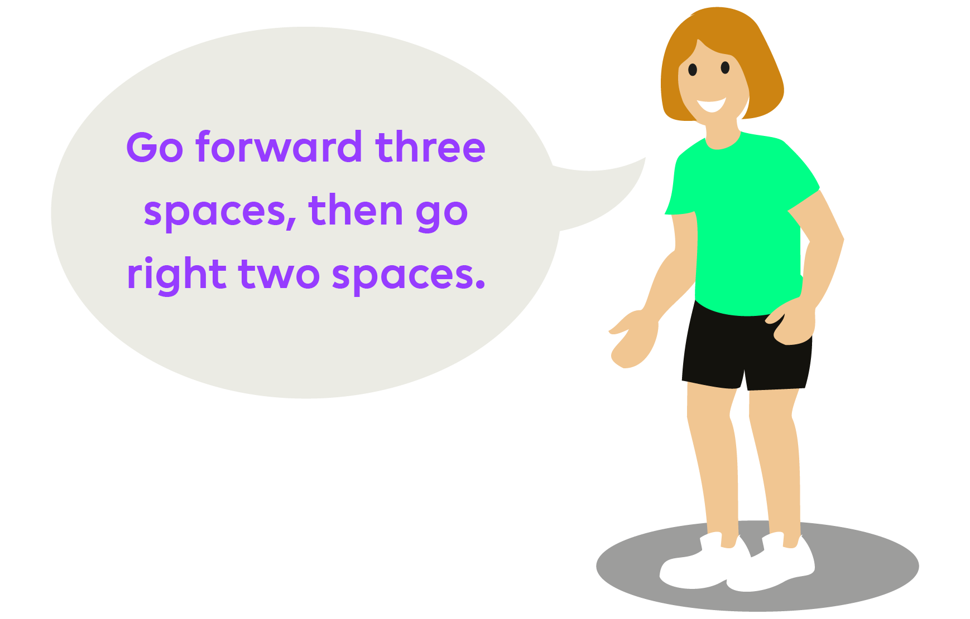
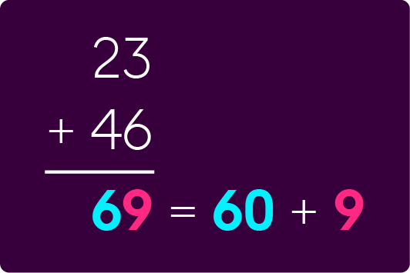
Direction
It will also be necessary to provide instructions to give someone directions.
Key words
Here is an example instruction:

Slide 6
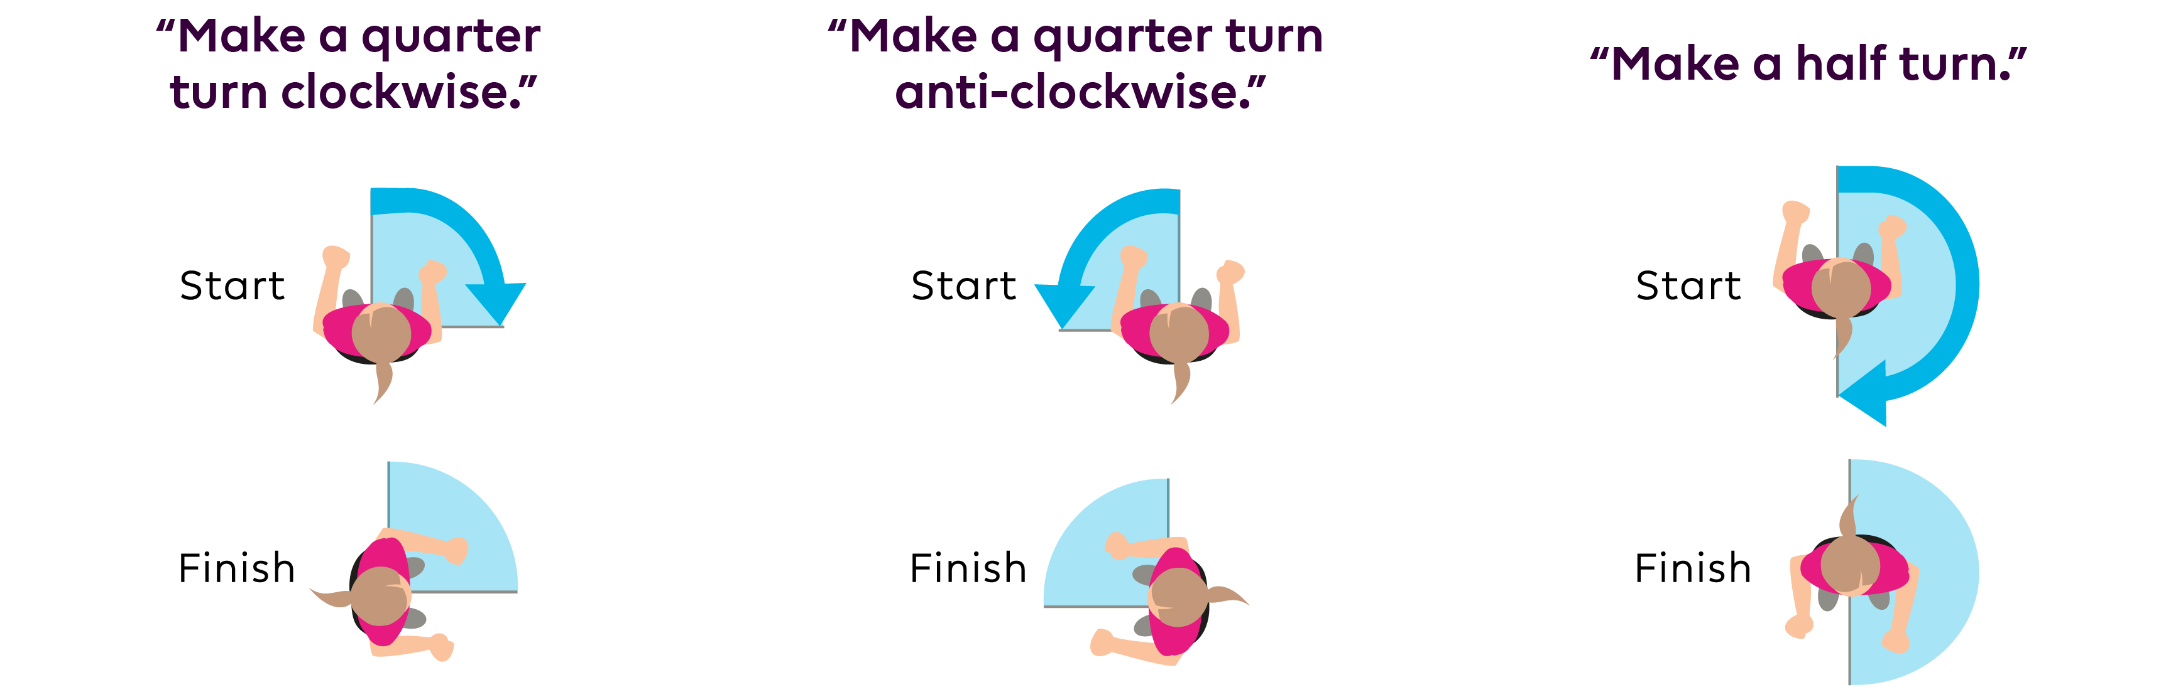
It may also help to be able to describe different turns when giving instructions:

Slide 7
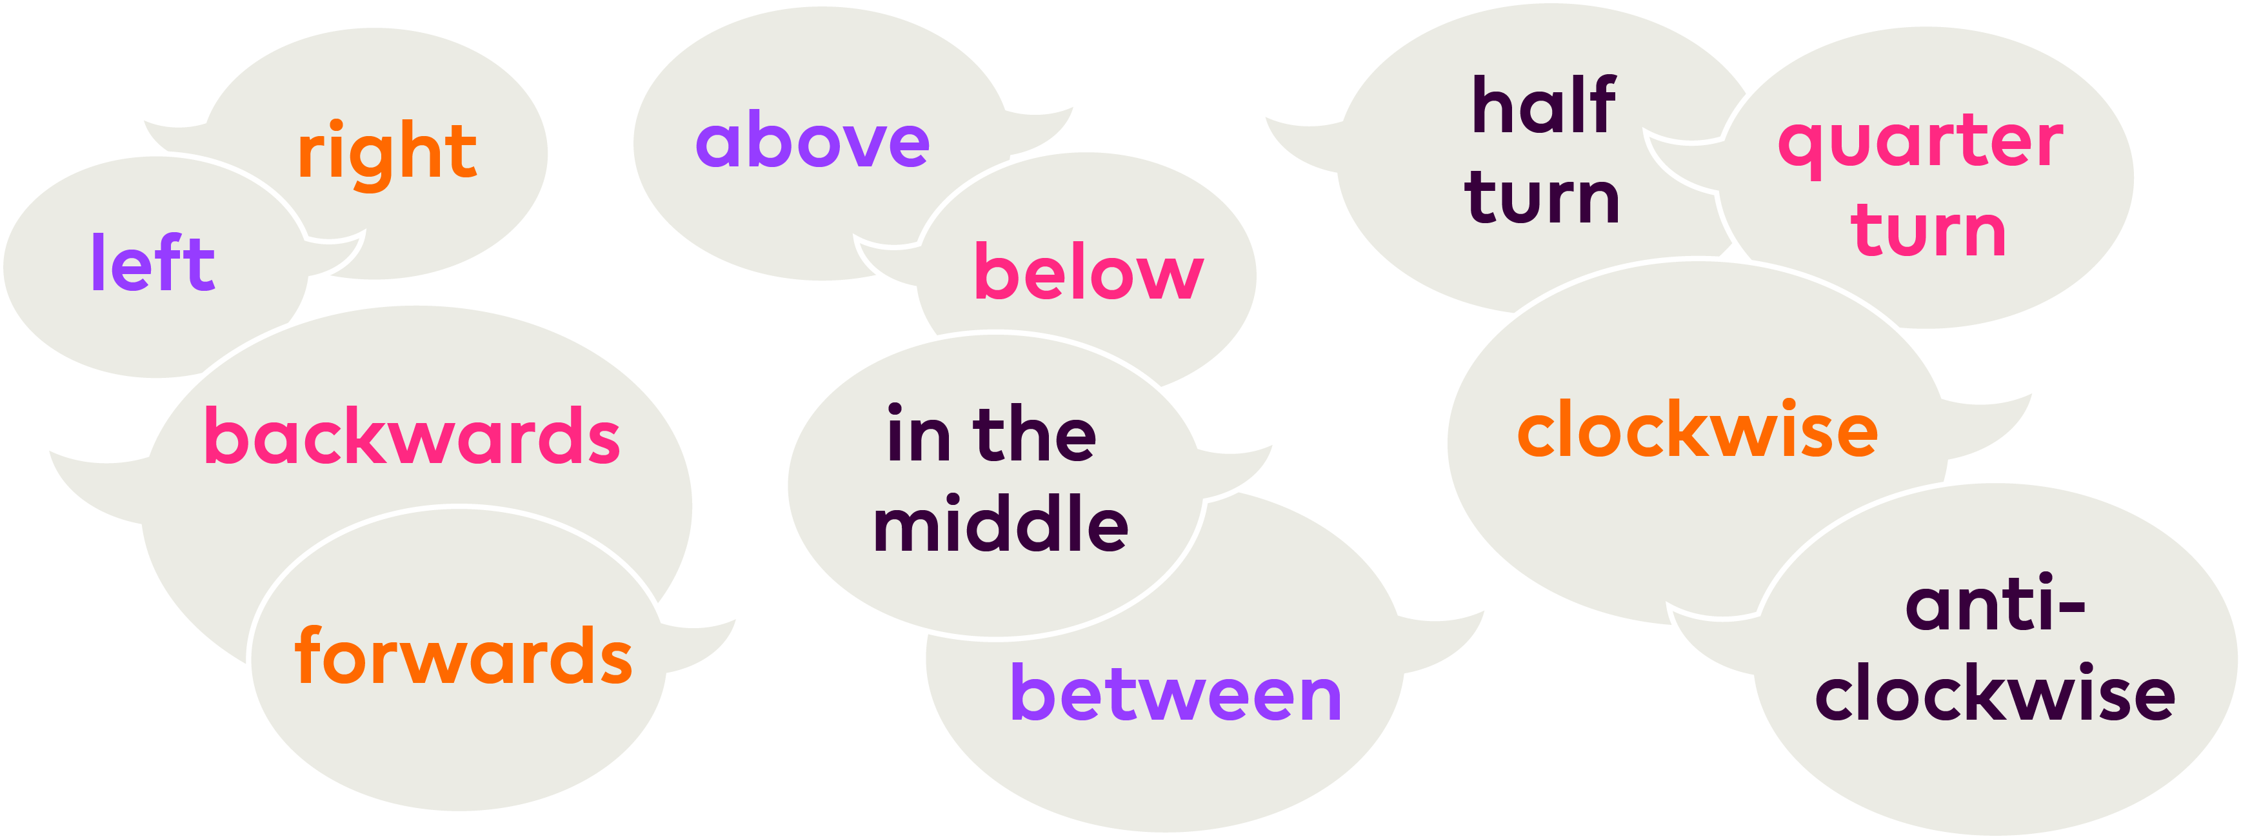
Practise using position and direction vocabulary around your home

